Slide 1

TOPSELLER
QUICK REFERENCE GUIDE
Canada | May 2023
V1 2023

Slide 2
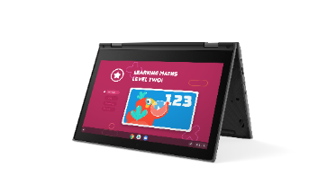
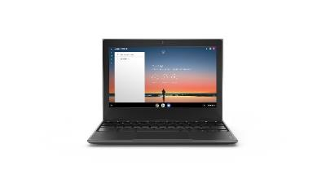
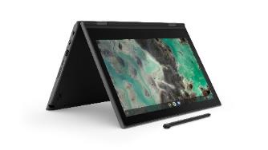
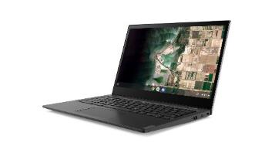
LENOVO TOPSELLERS - EDUCATION
[ 1 OF 1 ]
100e Chromebook G4 – MTK | $369
 | 82W00001US
 | 82W00001CF
 | MediaTek MT8183
 | 4GB (soldered)
 | 32GB eMMC (soldered)
 | 11.6” HD TN Anti-glare
 | HD Camera, 2x2 AX WLAN, BT
 | 47Whr Battery
 | Chrome OS
 | 1 Year Mail-in
100e Chromebook G2 – Intel | $399
 | 81M80084US
 | 81M80085CF
 | Intel Celeron N4020
 | 4GB (soldered)
 | 128GB SSD NVMe
 | 11.6” HD TN Anti-glare
 | HD Camera, 2x2 AC WLAN, BT
 | 42Whr Battery
 | Chrome OS
 | 1 Year Mail-in
100e Chromebook G3 – Intel | $459
 | 82UY0000US
 | Intel Celeron N4500
 | 4GB (soldered)
 | 32GB eMMC (soldered)
 | 11.6” HD TN Anti-glare
 | Camera, 2x2 AC WLAN, BT
 | 42Whr Battery
 | Chrome OS
 | 1 Year Mail-in
500e Chromebook G3 | $589 | $639
 | 82JB003XUS | 82JB0001US
 | 82JB003XCF | 82JB0001CF
 | Intel Celeron N4500 | Intel Celeron N5100
 | 4GB (soldered) | 4GB (soldered)
 | 32GB eMMC (soldered) | 32GB eMMC (soldered)
 | 11.6" HD IPS Touch | 11.6" HD IPS Touch
 | HD Camera, 2x2 AX WLAN, BT | World Facing Camera, 2x2 AC WLAN, BT, Pen
 | 42Whr Battery | 42Whr Battery
 | Chrome OS | Chrome OS
 | 1 Year Mail-in | 1 Year Mail-in
14e Chromebook G2 – AMD | $499
 | 82W60000US
 | 82W60000CF
 | Intel N100
 | 4GB (soldered)
 | 32GB eMMC (soldered)
 | 14" FHD TN Anti-glare
 | HD Camera, 2x2 AX WLAN, BT
 | 57Whr Battery
 | Chrome OS
 | 1 Year Mail-in
300e Chromebook
300e Chromebook G4 – MTK | $449 | $499
 | 82W20003US | 82W20002US
 | 82W20003CF | 82W20002CF
 | MediaTek MT8183 | MediaTek MT8183
 | 4GB (soldered) | 4GB (soldered)
 | 32GB eMMC (soldered) | 32GB eMMC (soldered)
 | 11.6” HD IPS Touch | 11.6” HD IPS Touch
 | HD Camera, 2x2 AX WLAN, BT | World Facing Camera, 2x2 AX WLAN, BT, Pen
 | 47Whr Battery | 47Whr Battery
 | Chrome OS | Chrome OS
 | 1 Year Mail-in | 1 Year Mail-in
500e Chromebook
14e Chromebook
100e Chromebook

Slide 3
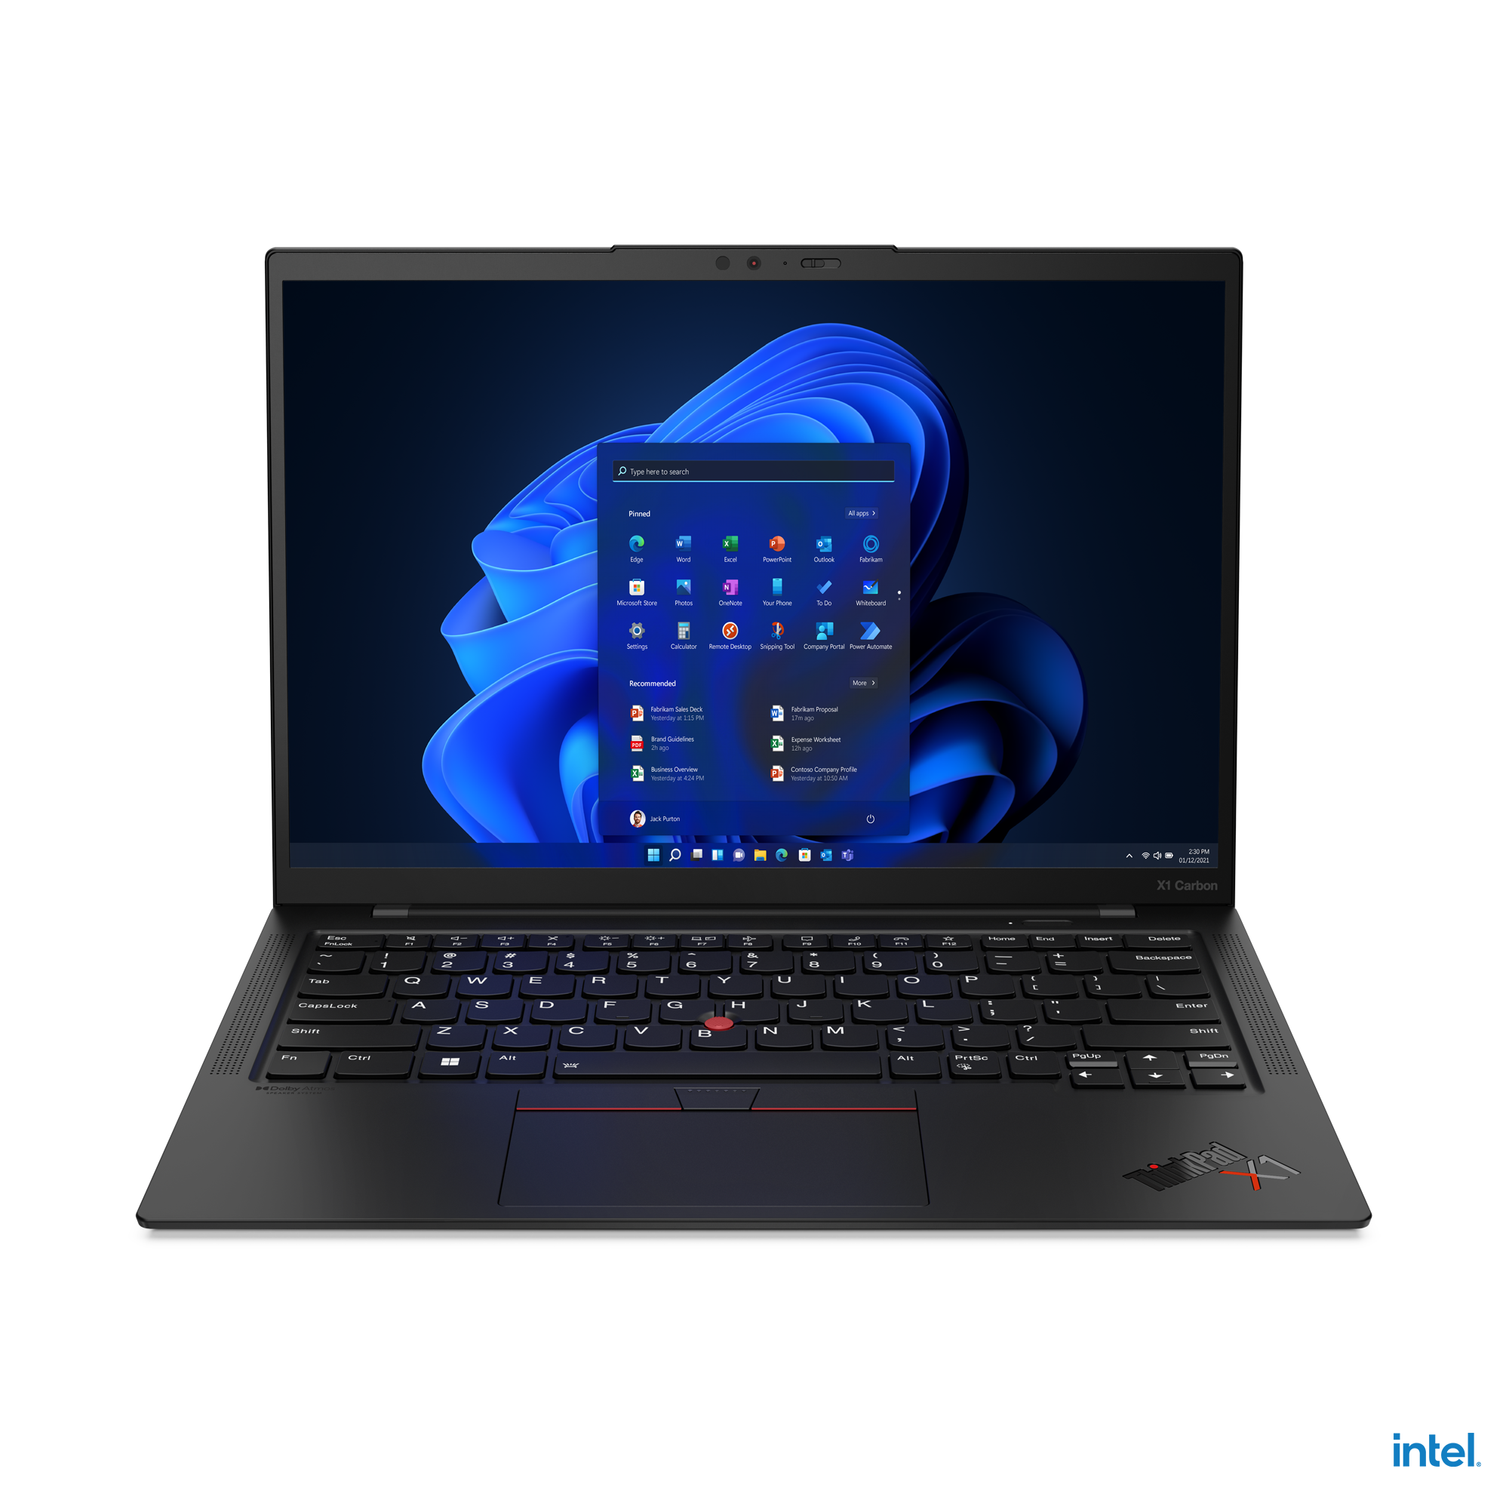
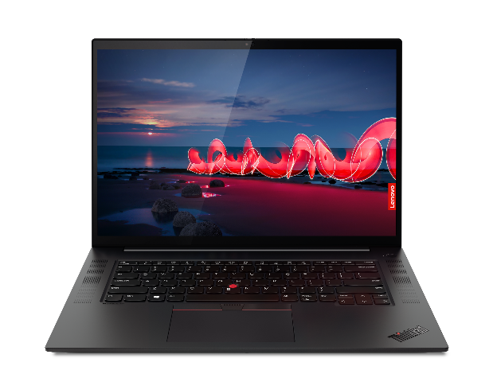
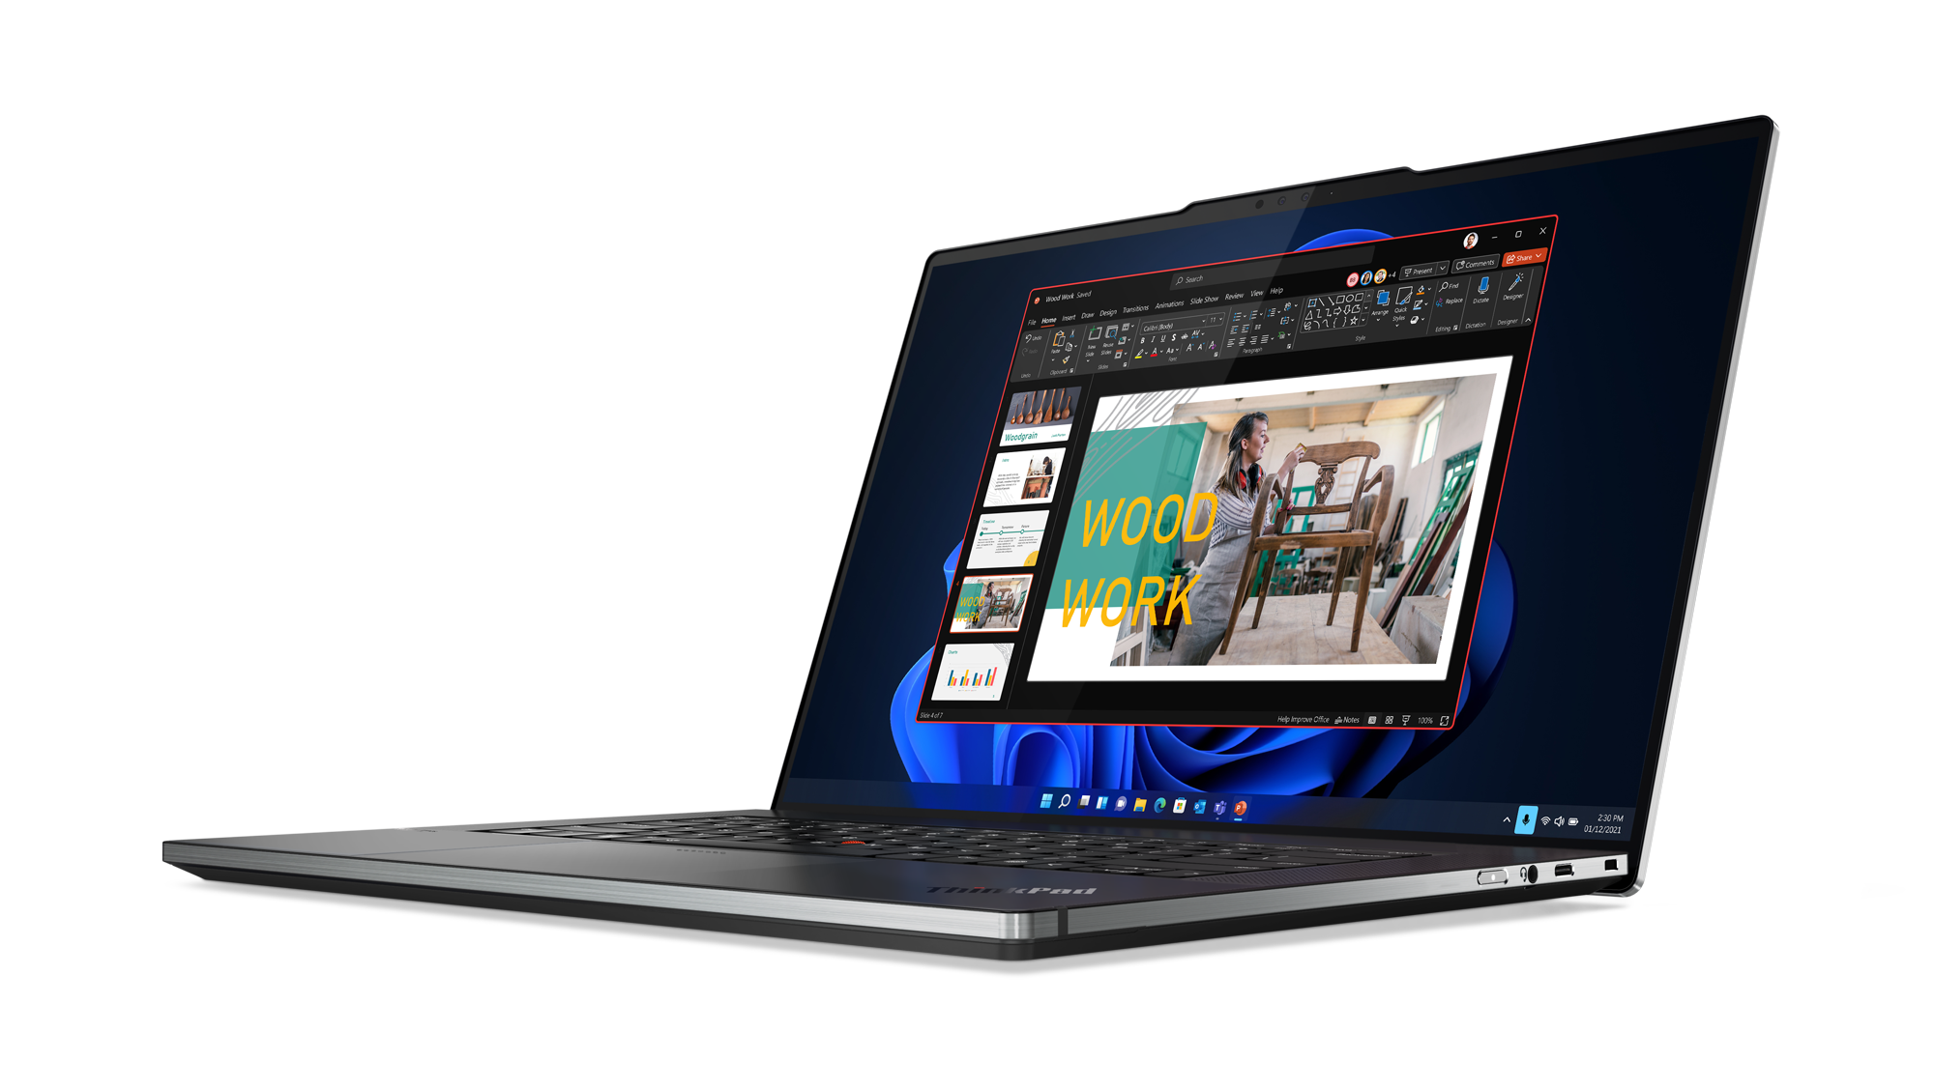
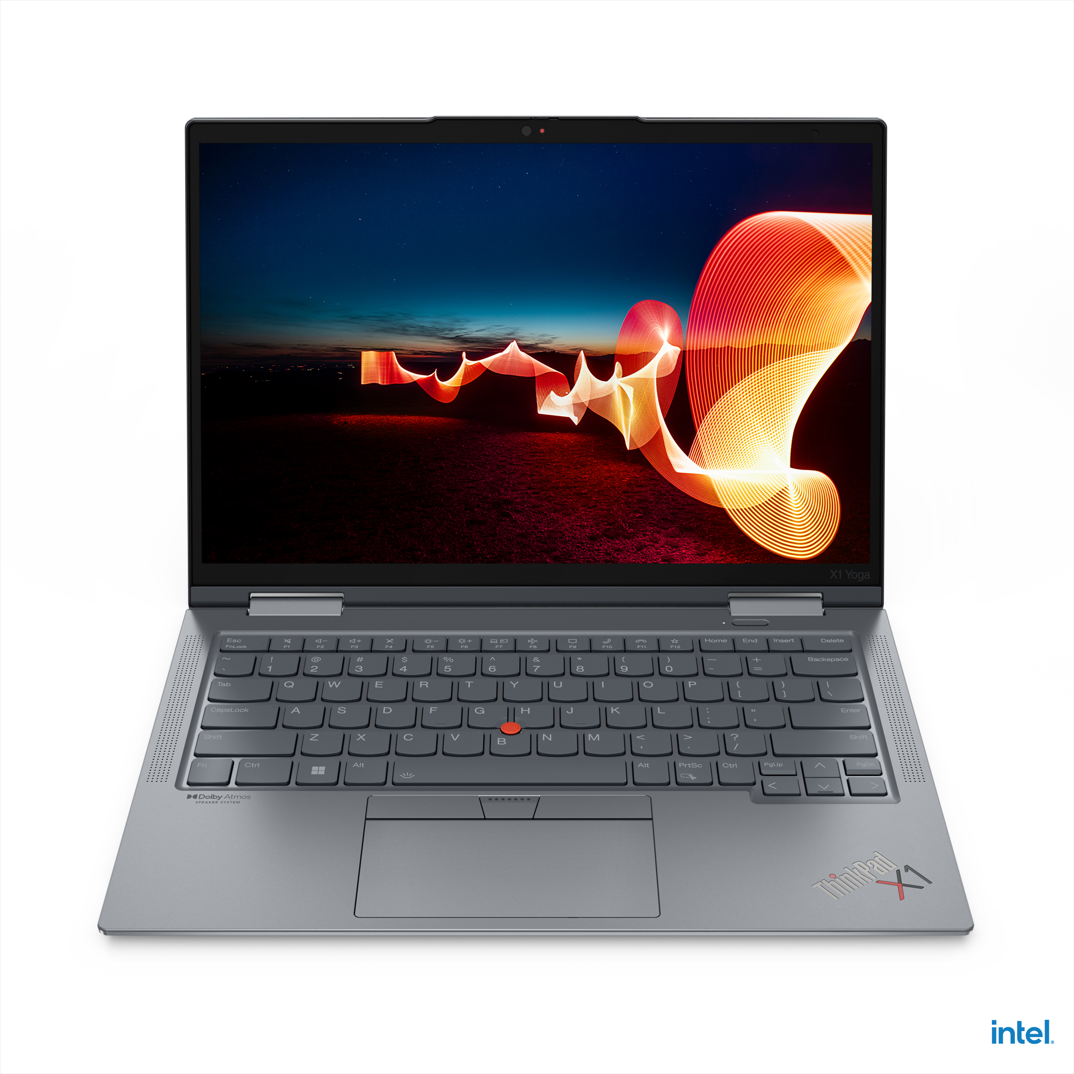
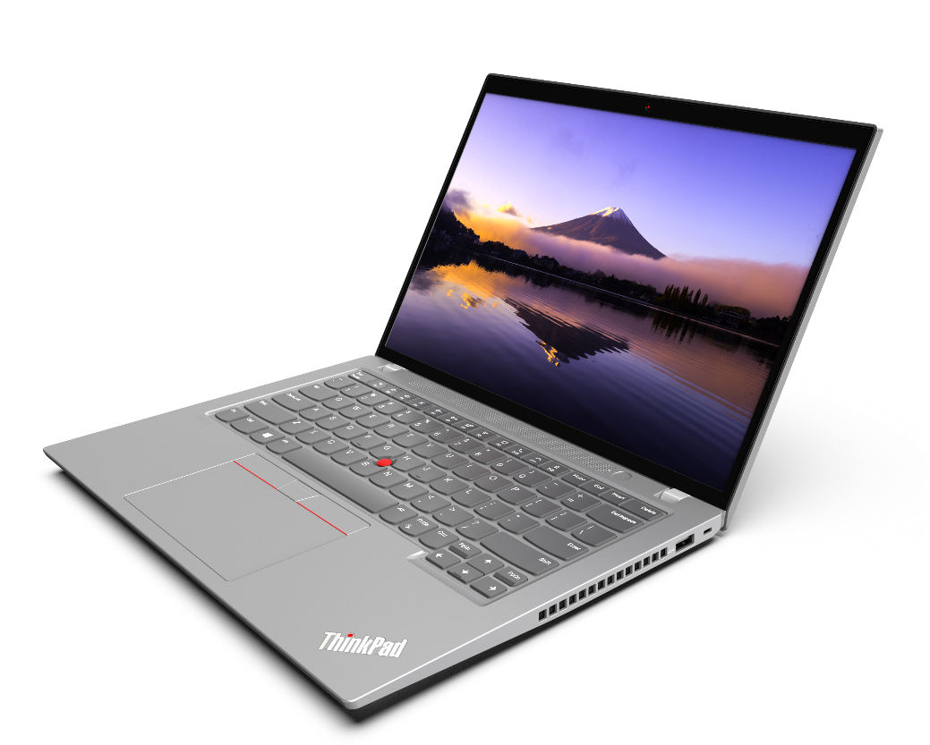
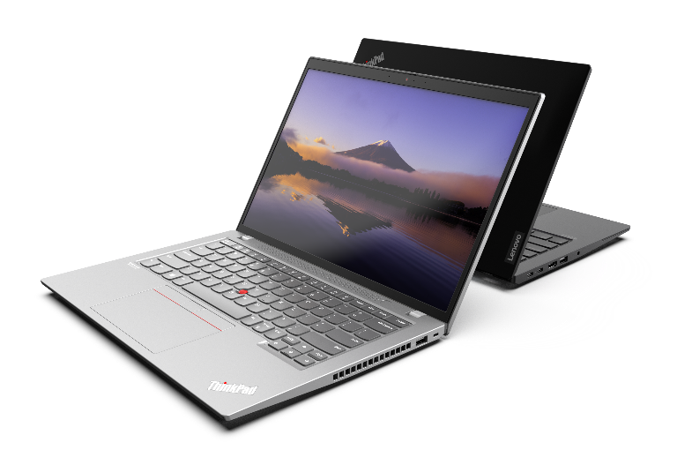
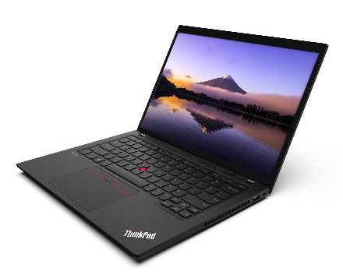
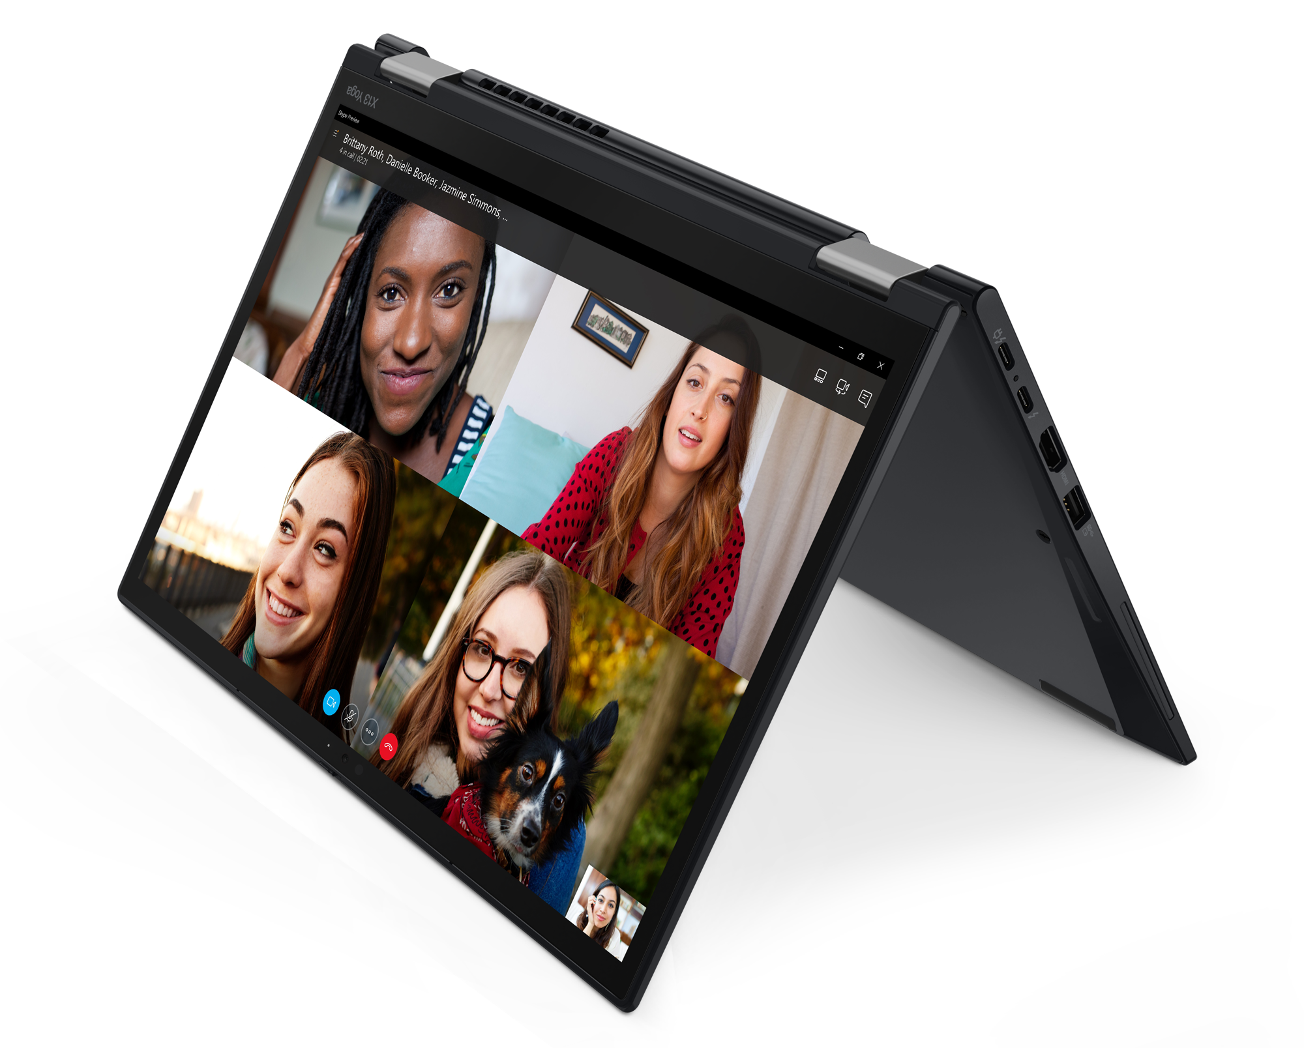
THINKPAD PREMIUM TOPSELLER NOTEBOOKS
[ 1 OF 4 ]
X1 Yoga 7th Gen
Z16 G1
X1 Carbon 10th Gen
X1 Extreme 5th Gen
X13 Yoga G3
T14 G3 (Intel/AMD)
T14s G3 (Intel/AMD)
T16 G1 (Intel/AMD)

Slide 4
THINKPAD PREMIUM TOPSELLER NOTEBOOKS
X & Z Series
[ 2 OF 4 ]
X1 Carbon 10th Gen | $2589 | $3059 | $3259
 | 21CB000AUS | 21CB000CUS | 21CB009KUS
 | 21CB000ACA | 21CB000CCA | 21CB009KCA
 | Core i5-1240P | Core i7-1260P | Core i7-1270P
 | 16GB DIMM | 16GB DIMM | 16GB DIMM
 | 256GB SSD NVMe | 512GB SSD NVMe | 512GB SSD NVMe
 | 14” WUXGA IPS Anti-glare | 14” WUXGA IPS Anti-glare Touch | 14” WUXGA IPS Anti-glare Touch
 | Camera w/Shutter, FPR, 2x2 AX WLAN, BT, Backlit Keyboard, Carbon Fiber | Camera w/Shutter, FPR, 2x2 AX WLAN, BT, Backlit Keyboard, Carbon Fiber | Camera w/Shutter, FPR, 2x2 AX WLAN, BT, Backlit Keyboard, Carbon Fiber
 | Integrated 57Whr Battery | Integrated 57Whr Battery | Integrated 57Whr Battery
 | Win11 Pro DG Win10 | Win11 Pro DG Win10 | Win11 Pro DG Win10
 | 3 Year Depot | 3 Year Depot | 3 Year Depot
X1 Yoga 7th Gen | $2769 | $3219
 | 21CD0045US | 21CD000GUS
 | 21CD0045CA | 21CD000GCA
 | Core i5-1235U | Core i7-1260P
 | 16GB DIMM | 16GB DIMM
 | 256GB SSD NVMe | 512GB SSD NVMe
 | 14” WUXGA IPS Anti-glare Touch | 14” WUXGA IPS Anti-glare Touch
 | Camera w/Shutter, FPR, 2x2 AX WLAN, BT, Backlit Keyboard, Carbon Fiber | Camera w/Shutter, FPR, 2x2 AX WLAN, BT, Backlit Keyboard, Carbon Fiber
 | Integrated 57Whr Battery | Integrated 57Whr Battery
 | Win11 Pro DG Win10 | Win11 Pro DG Win10
 | 3 Year Depot | 3 Year Depot
X13 Yoga Gen 3 | $2199 | $2389
 | 21AW002MUS | 21AW002NUS
 | 21AW002MCA | 21AW002NCA
 | Core i5-1235U | Core i7-1255U
 | 16GB DIMM | 16GB DIMM
 | 256GB SSD NVMe | 256GB SSD NVMe
 | 13.3” WUXGA IPS Anti-glare Touch | 13.3” WUXGA IPS Anti-glare Touch
 | Camera w/Shutter, FPR, 2x2 AX WLAN, BT, Backlit Keyboard | Camera w/Shutter, FPR, 2x2 AX WLAN, BT, Backlit Keyboard
 | Integrated 52.8Whr Battery | Integrated 52.8Whr Battery
 | Win11 Pro DG Win10 | Win11 Pro DG Win10
 | 3 Year Depot | 3 Year Depot
X1 Extreme Gen 5 | $3249
 | 21DE0049US
 | 21DE0049CA
 | Core i5-1235U
 | 16GB DIMM
 | 256GB SSD NVMe
 | 13.3” WUXGA IPS Anti-glare Touch
 | Camera w/Shutter, FPR, 2x2 AX WLAN, BT, Backlit Keyboard
 | Integrated 52.8Whr Battery
 | Win11 Pro DG Win10
 | 3 Year Depot
Z16 Gen 1 | $2479 | $2539
 | 21D4001UUS | 21D4001VUS
 | 21D4001UCA | 21D4001VCA
 | Ryzen 5 Pro 6650H | Ryzen 7 Pro 6850H
 | 16GB DIMM | 16GB DIMM
 | 256GB SSD NVMe | 512GB SSD NVMe
 | 16” WUXGA IPS Anti-glare | 16” WUXGA IPS Anti-glare
 | Camera w/Shutter, FPR, 2x2 AX WLAN, BT, Backlit Keyboard, Aluminum | Camera w/Shutter, FPR, 2x2 AX WLAN, BT, Backlit Keyboard, Aluminum
 | Integrated 72Whr Battery | Integrated 72Whr Battery
 | Win11 Pro DG Win10 | Win11 Pro DG Win10
 | 3 Year Depot | 3 Year Depot
X1 Carbon 10th Gen
Z16 Gen 1

Slide 5


THINKPAD PREMIUM TOPSELLER NOTEBOOKS
T Series – Intel
[ 3 OF 4 ]
T14 G3 – Intel | $2269 Rebate $150 | $2419 Rebate $75 | $2489 Rebate $75 | $2569 Rebate $50 | $2619 | $3109 Rebate $100
 | 21AH00BQUS | 21AH00BPUS | 21AH00BRUS | 21AH00BLUS | 21AH00BSUS | 21AH00BNUS
 | 21AH00BQCA | 21AH00BPCA | 21AH00BRCA | 21AH00BLCA | 21AH00BSCA | 21AH00BNCA
 | Core i5-1235U | Core i5-1235U | Core i5-1235U | Core i7-1245U | Core i7-1260P | Core i7-1270P
 | 8GB DIMM | 8GB DIMM | 8GB DIMM | 8GB DIMM | 8GB DIMM | 8GB DIMM
 | 256GB SSD NVMe | 512GB SSD NVMe | 512GB SSD NVMe | 512GB SSD NVMe | 512GB SSD NVMe | 512GB SSD NVMe
 | 14” WUXGA IPS Anti-glare | 14” WUXGA IPS Anti-glare | 14” WUXGA IPS Anti-glare Touch | 14” WUXGA IPS Anti-glare | 14” WUXGA IPS Anti-glare | 14” 2.2K IPS Anti-glare
 | Camera w/Shutter, FPR, 2x2 AX WLAN, BT, Backlit Keyboard | Camera w/Shutter, FPR, 2x2 AX WLAN, BT, Backlit Keyboard | Camera w/Shutter, FPR, 2x2 AX WLAN, BT, Backlit Keyboard | Camera w/Shutter, FPR, 2x2 AX WLAN, BT, Backlit Keyboard | IR Camera w/Shutter, FPR, 2x2 AX WLAN, BT, Backlit Keyboard | IR Camera w/Shutter, FPR, 2x2 AX WLAN, BT, Backlit Keyboard
 | Integrated 52.5Whr Battery | Integrated 52.5Whr Battery | Integrated 52.5Whr Battery | Integrated 52.5Whr Battery | Integrated 52.5Whr Battery | Integrated 52.5Whr Battery
 | Win11 Pro DG Win10 | Win11 Pro DG Win10 | Win11 Pro | Win11 Pro DG Win10 | Win11 Pro DG Win10 | Win11 Pro DG Win10
 | 3 Year Depot | 3 Year Depot | 3 Year Depot | 3 Year Depot | 3 Year Depot | 3 Year Depot
T14s G3 – Intel | $2679 | $2789 | $3069
 | 21BR000DUS | 21BR002TUS | 21BR002VUS
 | 21BR000DCA | 21BR002TCA | 21BR002VCA
 | Core i5-1250P | Core i7-1260P | Core i7-1270P
 | 16GB DIMM | 16GB DIMM | 16GB DIMM
 | 256GB SSD NVMe | 512GB SSD NVMe | 512GB SSD NVMe
 | 14” WUXGA IPS Anti-glare Touch | 14” WUXGA IPS Anti-glare | 14” WUXGA IPS Anti-glare Touch
 | Camera w/Shutter, FPR, 2x2 AX WLAN, BT, Backlit Keyboard, Aluminum | Camera w/Shutter, FPR, 2x2 AX WLAN, BT, Backlit Keyboard, Aluminum | Camera w/Shutter, FPR, 2x2 AX WLAN, BT, Backlit Keyboard, Aluminum
 | Integrated 57Whr Battery | Integrated 57Whr Battery | Integrated 57Whr Battery
 | Win11 Pro DG Win10 | Win11 Pro DG Win10 | Win11 Pro DG Win10
 | 3 Year Depot | 3 Year Depot | 3 Year Depot
T16 G1 – Intel | $2169 Rebate $100 | $2449 | $2659 | $2939 Rebate $25
 | 21BV0091US | 21BV0097US | 21BV0090US | 21BV0096US
 | 21BV0091CA | 21BV0097CA |  | 21BV0096CA
 | Core i5-1235U | Core i5-1235U | Core i7-1260P | Core i7-1270P
 | 8GB DIMM | 8GB DIMM + 8GB DIMM | 8GB DIMM + 8GB DIMM | 8GB DIMM + 8GB DIMM
 | 256GB SSD NVMe | 512GB SSD NVMe | 512GB SSD NVMe | 512GB SSD NVMe
 | 16” WUXGA IPS Anti-glare | 16” WUXGA IPS Anti-glare | 16” WUXGA IPS Anti-glare | 16” WUXGA IPS Anti-glare, Touch
 | IR Camera w/Shutter, FPR, 2x2 AX WLAN, BT, Backlit Keyboard | IR Camera w/Shutter, FPR, 2x2 AX WLAN, BT, Backlit Keyboard | IR Camera w/Shutter, FPR, 2x2 AX WLAN, BT, Backlit Keyboard | IR Camera w/Shutter, FPR, 2x2 AX WLAN, BT, Backlit Keyboard
 | Integrated 86Whr Battery | Integrated 86Whr Battery | Integrated 86Whr Battery | Integrated 86Whr Battery
 | Win11 Pro DG Win10 | Win11 Pro DG Win10 | Win11 Pro DG Win10 | Win11 Pro DG Win10
 | 3 Year Depot | 3 Year Depot | 3 Year Depot | 3 Year Depot
T14 Gen 3
T14s Gen 3

Slide 6


LENOVO PREMIUM TOPSELLER NOTEBOOKS
T Series – AMD
[ 4 OF 4 ]
T14 G3 – AMD | $2039 Rebate $50 | $2129 Rebate $150 | $2469 Rebate $75 | $2489 Rebate $175
 | 21CF000BUS | 21CF000CUS | 21CF000DUS | 21CF000EUS
 | 21CF000BCA | 21CF000CCA | 21CF000DCA | 21CF000ECA
 | Ryzen 5 Pro 6650U | Ryzen 5 Pro 6650U | Ryzen 7 Pro 6850U | Ryzen 7 Pro 6850U
 | 16GB DIMM | 16GB DIMM | 16GB DIMM | 16GB DIMM
 | 256GB SSD NVMe | 256GB SSD NVMe | 512GB SSD NVMe | 512GB SSD NVMe
 | 14” WUXGA IPS Anti-glare | 14” WUXGA IPS Anti-glare Touch | 14” WUXGA IPS Anti-glare Touch | 14” WUXGA IPS Anti-glare Touch
 | Camera w/Shutter, FPR, 2x2 AX WLAN, BT, Backlit Keyboard, Black | IR Camera w/Shutter, FPR, 2x2 AX WLAN, BT, Backlit Keyboard, Grey | Camera w/Shutter, FPR, 2x2 AX WLAN, BT, Backlit Keyboard, Black | IR Camera w/Shutter, FPR, 2x2 AX WLAN, BT, Backlit Keyboard, Grey
 | Integrated 52.5Whr Battery | Integrated 52.5Whr Battery | Integrated 52.5Whr Battery | Integrated 52.5Whr Battery
 | Win11 Pro DG Win10 | Win11 Pro DG Win10 | Win11 Pro DG Win10 | Win11 Pro
 | 3 Year Depot | 3 Year Depot | 3 Year Depot | 3 Year Depot
T14s G3 – AMD | $2179 | $2649
 | 21CQ000HUS | 21CQ002JUS
 | 21CQ002HCA | 21CQ002JCA
 | Ryzen 5 Pro 6650U | Ryzen 7 Pro 6850U
 | 16GB DIMM | 16GB DIMM
 | 256GB SSD NVMe | 512GB SSD NVMe
 | 14” WUXGA IPS Anti-glare | 14” WUXGA IPS Anti-glare Touch
 | Camera w/Shutter, FPR, 2x2 AX WLAN, BT, Backlit Keyboard | IR Camera w/Shutter, FPR, 2x2 AX WLAN, BT, Backlit Keyboard
 | Integrated 57Whr Battery | Integrated 57Whr Battery
 | Win11 Pro DG Win10 | Win11 Pro DG Win10
 | 3 Year Depot | 3 Year Depot
T16 G1 – AMD | $2079 | $2489 Rebate $100
 | 21CH0004US | 21CH0006US
 | 21CH0004CA | 21CH0006CA
 | Ryzen 5 Pro 6650U | Ryzen 7 Pro 6850U
 | 16GB DIMM | 16GB DIMM
 | 256GB SSD NVMe | 512GB SSD NVMe
 | 16” WUXGA IPS Anti-glare | 16” WUXGA IPS Anti-glare Touch
 | Camera w/Shutter, FPR, 2x2 AX WLAN, BT, Backlit Keyboard | Camera w/Shutter, FPR, 2x2 AX WLAN, BT, Backlit Keyboard
 | Integrated 52.5Whr Battery | Integrated 52.5Whr Battery
 | Win11 Pro DG Win10 | Win11 Pro DG Win10
 | 3 Year Depot | 3 Year Depot
T16 Gen 1 – AMD

Slide 7
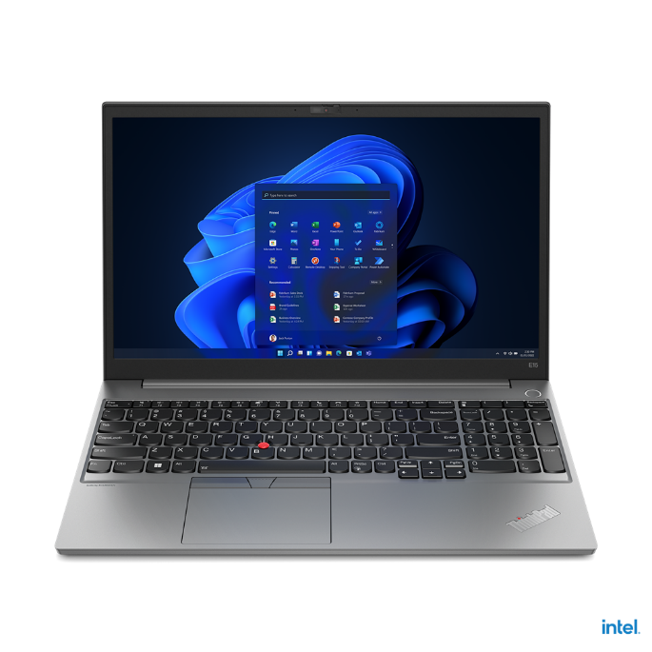

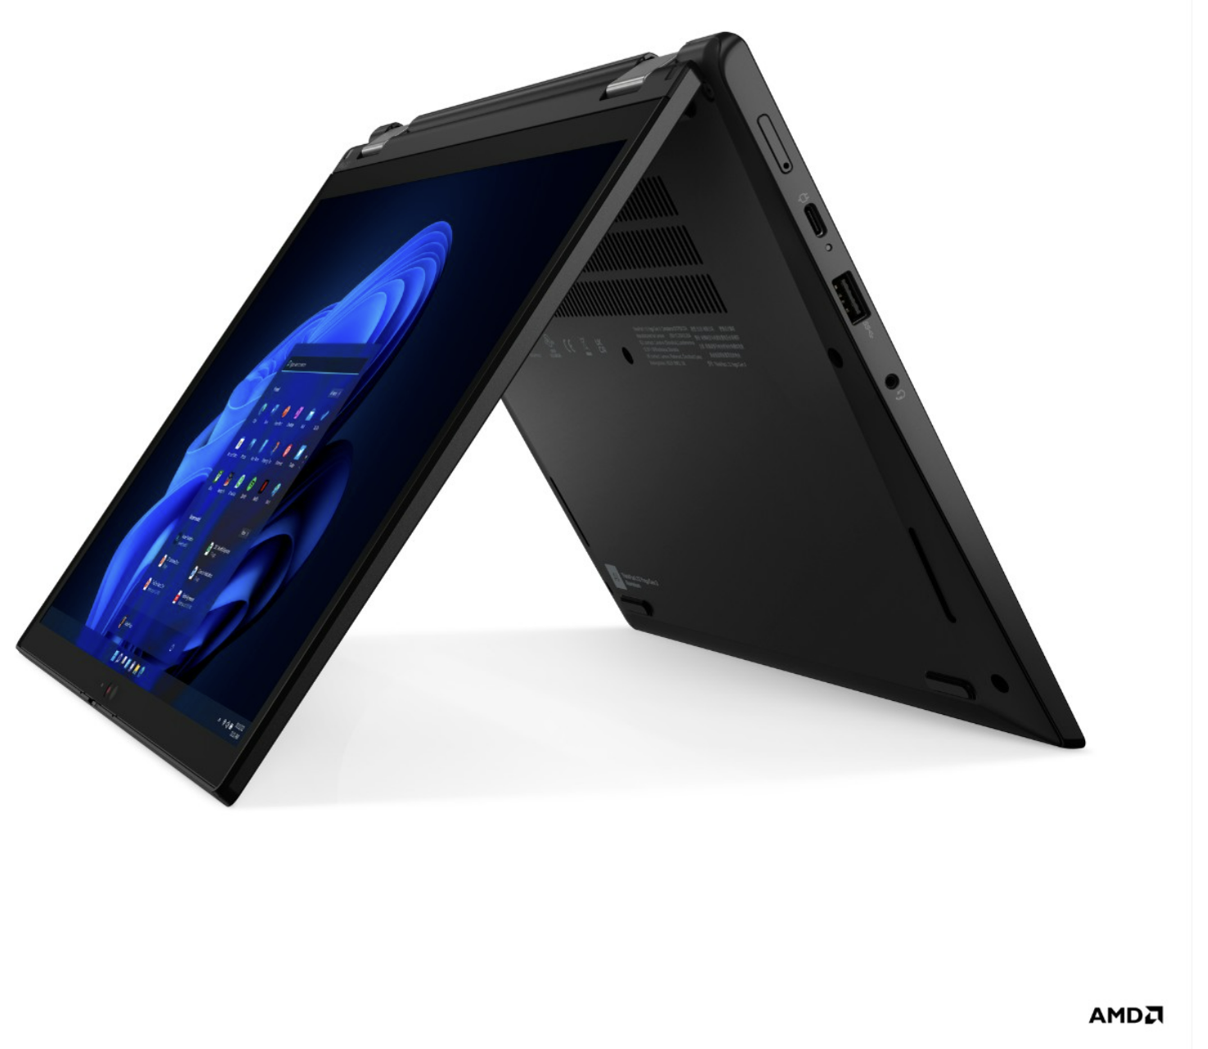
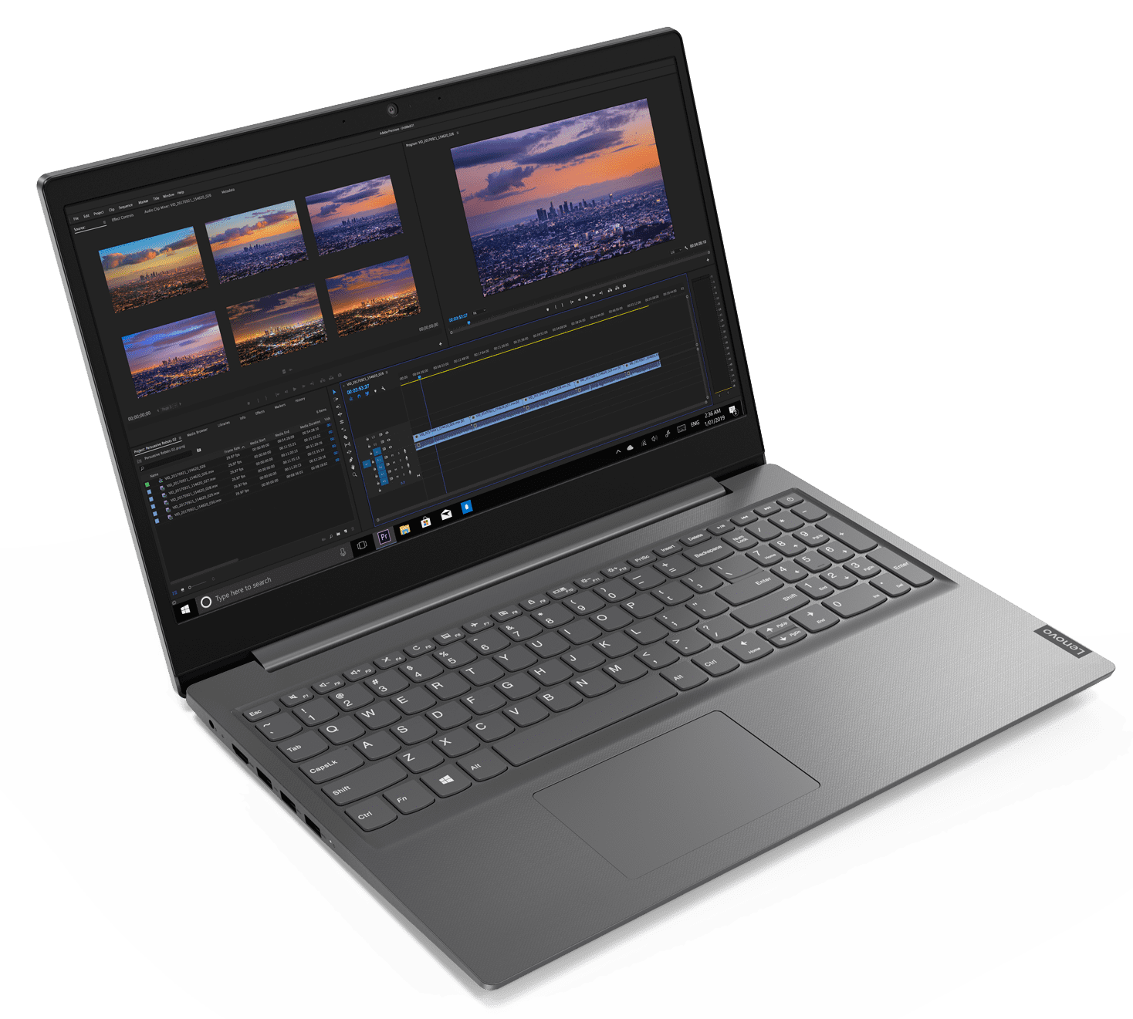
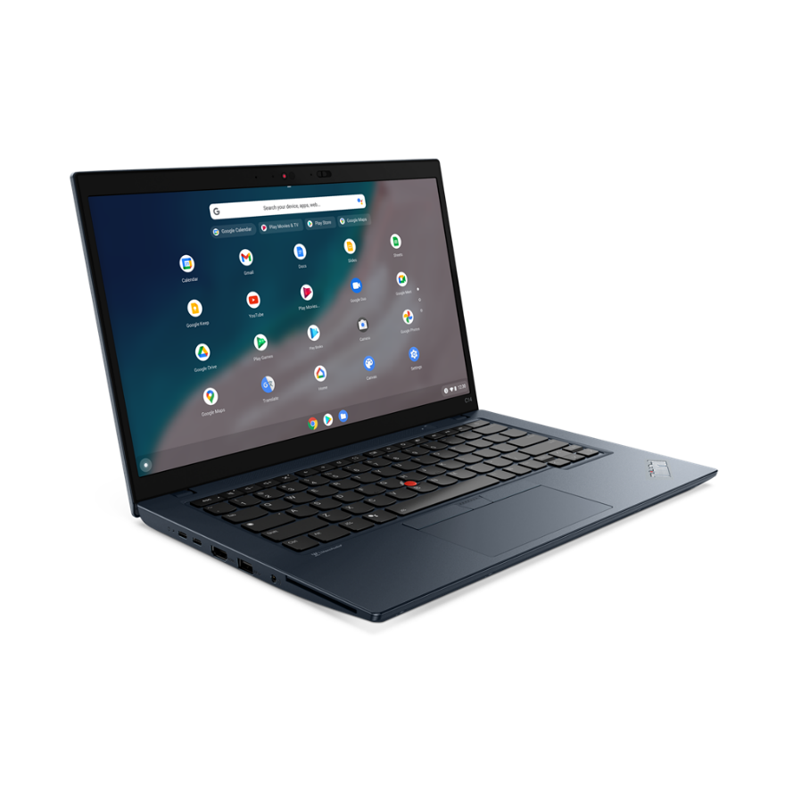
THINKPAD VELOCITY TOPSELLER NOTEBOOKS
[ 1 OF 4 ]
E14 (Intel / AMD)
E15 (Intel/AMD)
L13 Yoga
C14 (Chrome)
Lenovo V15

Slide 8

THINKPAD VELOCITY TOPSELLER NOTEBOOKS
E Series
[ 2 OF 4 ]
E14 G4 – Intel | $1289 Rebate $50 | $1359 Rebate $50 | $1629 Rebate $40
 | 21E3008HUS | 21E3008FUS | 21E3008BUS
 | 21E3008HCA | 21E3008FCA | 21E3008BCA
 | Core i5-1235U | Core i5-1235U | Core i7-1255U
 | 8GB DIMM | 8GB DIMM + 8GB DIMM | 8GB DIMM + 8GB DIMM
 | 256GB SSD NVMe | 256GB SSD NVMe | 512GB SSD NVMe
 | 14” FHD IPS Anti-glare | 14” FHD IPS Anti-glare | 14” FHD IPS Anti-glare
 | Camera w/Shutter, 2x2 AX WLAN, BT | Camera w/Shutter, 2x2 AX WLAN, BT | Camera w/Shutter, 2x2 AX WLAN, BT
 | Integrated 57Whr Battery | Integrated 57Whr Battery | Integrated 57Whr Battery
 | Win11 Pro DG Win10 | Win11 Pro DG Win10 | Win11 Pro DG Win10
 | 1 Year Depot | 1 Year Depot | 1 Year Depot
E15 G4 – Intel | $1279 Rebate $30 | $1279 | $1359 Rebate $50 | $1619 Rebate $50
 | 21E6007FUS | 21E6007BUS | 21E6007DUS | 21E6007GUS
 | 21E6007FCA | 21E6007BCA | 21E6007DCA | 21E6007GCA
 | Core i5-1235U | Core i5-1235U | Core i7-1255U | Core i7-1255U
 | 8GB DIMM | 8GB DIMM | 8GB DIMM + 8GB DIMM | 8GB DIMM + 8GB DIMM
 | 256GB SSD NVMe | 256GB SSD NVMe | 256GB SSD NVMe | 512GB SSD NVMe
 | 15.6” FHD IPS Anti-glare | 15.6” FHD IPS Anti-glare | 15.6” FHD IPS Anti-glare | 15.6” FHD IPS Anti-glare
 | Camera w/Shutter, 2x2 AX WLAN, BT | Camera w/Shutter, 2x2 AX WLAN, BT | Camera w/Shutter, 2x2 AX WLAN, BT | Camera w/Shutter, 2x2 AX WLAN, BT
 | Integrated 45Whr Battery | Integrated 45Whr Battery | Integrated 45Whr Battery | Integrated 45Whr Battery
 | Win11 Pro DG Win10 | Win11 Pro | Win11 Pro DG Win10 | Win11 Pro
 | 1 Year Depot | 1 Year Depot | 1 Year Depot | 1 Year Depot
E14 (Intel/AMD)
E14 G4 – AMD | $1119 Rebate $80 | $1199 Rebate $55
 | 21EB001PUS | 21EB001RUS
 | 21EB001PCA | 21EB001RCA
 | Ryzen 5 5625U | Ryzen 5 5625U
 | 8GB DIMM | 8GB DIMM + 8GB DIMM
 | 256GB SSD NVMe | 256GB SSD NVMe
 | 14” FHD IPS Anti-glare | 14” FHD IPS Anti-glare
 | Camera w/Shutter, 2x2 AX WLAN, BT | Camera w/Shutter, 2x2 AX WLAN, BT
 | Integrated 45Whr Battery | Integrated 45Whr Battery
 | Win11 Pro DG Win10 | Win11 Pro DG Win10
 | 1 Year Depot | 1 Year Depot
E15 G4 – AMD | $1119 Rebate $40 | $1279 Rebate $50 | $1289 | $1459 Rebate $80
 | 21ED003WUS | 21ED0041US | 21ED003YUS | 21ED0043US
 | 21ED003WCA | 21ED0041CA | 21ED003YCA | 21ED0043CA
 | Ryzen 5 5625U | Ryzen 7 5825U | Ryzen 5 5625U | Ryzen 7 5825U
 | 8GB DIMM | 8GB DIMM | 8GB DIMM + 8GB DIMM | 8GB DIMM + 8GB DIMM
 | 256GB SSD NVMe | 256GB SSD NVMe | 512GB SSD NVMe | 512GB SSD NVMe
 | 15.6” FHD IPS Anti-glare | 15.6” FHD IPS Anti-glare | 15.6” FHD IPS Anti-glare | 15.6” FHD IPS Anti-glare
 | Camera w/Shutter, 2x2 AX WLAN, BT | Camera w/Shutter, 2x2 AX WLAN, BT | Camera w/Shutter, 2x2 AX WLAN, BT | Camera w/Shutter, 2x2 AX WLAN, BT
 | Integrated 45Whr Battery | Integrated 45Whr Battery | Integrated 45Whr Battery | Integrated 45Whr Battery
 | Win11 Pro DG Win10 | Win11 Pro DG Win10 | Win11 Pro DG Win10 | Win11 Pro DG Win10
 | 1 Year Depot | 1 Year Depot | 1 Year Depot | 1 Year Depot
E15 (Intel/AMD)

Slide 9
THINKPAD VELOCITY TOPSELLER NOTEBOOKS
L13 Yoga / V Series / Enterprise Chrome
[ 3 OF 4 ]
L13 Yoga – Intel | $2159
 | 21B5003XUS
 | 21B5003XCA
 | Core i7-1255U
 | 16GB DIMM
 | 512GB SSD NVMe
 | 13.3” WUXGA IPS Anti-glare Touch
 | IR Camera w/Shutter, FPR, 2x2 AX WLAN, BT, Backlit Keyboard, Grey
 | Integrated 46Whr Battery
 | Win11 Pro DG Win10
 | 1 Year Depot
Lenovo V14 G3 -- AMD | $889
 | 82TU0004US
 | 82TU0005CA
 | Ryzen 5 5625U
 | 8GB DIMM
 | 256GB PCIe SSD
 | 14” FHD TN Anti-glare
 | Camera w/Shutter 2x2 AX WLAN-BT
 | Integrated 38Whr Battery
 | Win 11 Pro
 | 1 Year Depot
Lenovo V14 G3 -- Intel | $899
 | 82TS005QUS
 | 82TS005PCA
 | Core i5-1235U
 | 8GB DIMM
 | 256GB PCIe SSD
 | 14” FHD TN Anti-glare
 | Camera w/Shutter 2x2 AX WLAN-BT
 | Integrated 38Whr Battery
 | Win 11 Pro
 | 1 Year Depot
Lenovo V15 G3 -- AMD | $889 Rebate $15
 | 82TV001QUS
 | 82TV001RCA
 | Ryzen 5 5625U
 | 8GB DIMM
 | 256GB PCIe SSD
 | 15.6” FHD TN Anti-glare
 | Camera w/Shutter 2x2 AX WLAN-BT
 | 4 Cell 56Whr Battery
 | Win 11 Pro
 | 1 Year Depot
Lenovo V15 G3 -- Intel | $909
 | 82TT005GUS
 | 82TT005HCA
 | Core i5-1235U
 | 8GB DIMM
 | 256GB PCIe SSD
 | 15.6” FHD TN Anti-glare
 | Camera w/Shutter 2x2 AX WLAN-BT
 | 4 Cell 56Whr Battery
 | Win 11 Pro
 | 1 Year Depot
L13 Yoga
C14 Gen1 (Chrome) | $1449
 | 21C9000HUS
 | 21C9000HCZ
 | Core i5-1245U
 | 8GB DIMM
 | 256GB SSD NVMe
 | 14” FHD IPS Anti-glare
 | Camera w/Shutter, FPR, 2x2 AX WLAN, BT, Backlit Keyboard, Abyss Blue
 | Integrated 57Whr Battery
 | ChromeOS
 | 1 Year Depot
C14 (Chrome)
Lenovo V15

Slide 10
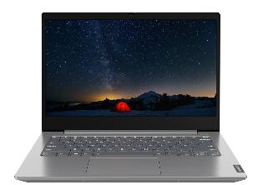
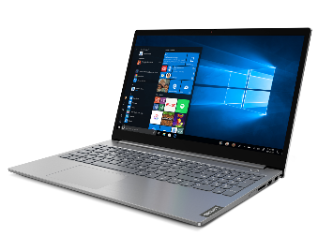
LENOVO TOPSELLER
ThinkBook
[ 4 OF 4 ]
ThinkBook 14 Gen4 - Intel | $1199 Rebate $50 | $1489 Rebate $75
 | 21DH000RUS | 21DH00DCUS
 | 21DH000SCA | 21DH00DDCA
 | Core i5-1235U | Core i7-1255U
 | 8GB DIMM | 8GB DIMM
 | 256GB SSD NVMe | 512GB SSD NVMe
 | 14” FHD IPS Anti-glare | 14” FHD IPS Anti-glare Touch
 | Camera w/Shutter, FPR, 2x2 AX WLAN, BT, Backlit Keyboard, Aluminum | Camera w/Shutter, FPR, 2x2 AX WLAN, BT, Backlit Keyboard, Aluminum
 | Integrated 45Whr Battery | Integrated 45Whr Battery
 | Win11 Pro | Win11 Pro DG Win10
 | 1 Year Depot | 1 Year Depot
ThinkBook 14 Gen4 - AMD | $1149 Rebate $25 | $1299 Rebate $40
 | 21DK004YUS | 21DK0051US
 | 21DK0050CA | 21DK0052CA
 | Ryzen 5 5625U | Ryzen 7 5825U
 | 8GB DIMM | 8GB DIMM
 | 256GB SSD NVMe | 512GB SSD NVMe
 | 14” FHD IPS Anti-glare | 14” FHD IPS Anti-glare
 | Camera w/Shutter, FPR, 2x2 AX WLAN, BT, Backlit Keyboard, Aluminum | Camera w/Shutter, FPR, 2x2 AX WLAN, BT, Backlit Keyboard, Aluminum
 | Integrated 45Whr Battery | Integrated 45Whr Battery
 | Win11 Pro DG Win10 | Win11 Pro DG Win10
 | 1 Year Depot | 1 Year Depot
ThinkBook 14s Gen3 | $1489 | $1729
 | 21JG0019US | 21JG001FUS
 | 21JG001ACA | 21JG001GCA
 | Core i5-1335U | Core i7-1355U
 | 16GB DIMM | 16GB DIMM
 | 256GB SSD NVMe | 512GB SSD NVMe
 | 14” FHD IPS Anti-glare Touch | 14” FHD IPS Anti-glare Touch
 | Camera w/Shutter, FPR, 2x2 AX WLAN, BT, Backlit Keyboard, Aluminum | Camera w/Shutter, FPR, 2x2 AX WLAN, BT, Backlit Keyboard, Aluminum
 | Integrated 60Whr Battery | Integrated 60Whr Battery
 | Win11 Pro | Win11 Pro
 | 1 Year Depot | 1 Year Depot
ThinkBook 14
ThinkBook 15 Gen4 - Intel | $1199 Rebate $40 | $1299 | $1379 Rebate $75 | $1489 Rebate $50 | $1489
 | 21DJ00G1US | 21DJ00G7US | 21DJ00G3US | 21DJ00G5US | 21DJ000VUS
 | 21DJ00G2CA | 21DJ00G8CA | 21DJ00G4CA | 21DJ00G6CA | 21DJ000WCA
 | Core i5-1235U | Core i5-1235U | Core i7-1255U | Core i7-1255U | Core i7-1255U
 | 8GB DIMM | 8GB DIMM | 8GB DIMM | 16GB DIMM | 16GB DIMM
 | 256GB SSD NVMe | 256GB SSD NVMe | 512GB SSD NVMe | 512GB SSD NVMe | 512GB SSD NVMe
 | 15.6” FHD IPS Anti-glare | 15.6” FHD IPS Anti-glare Touch | 15.6” FHD IPS Anti-glare | 15.6” FHD IPS Anti-glare, Touch | 15.6” FHD IPS Anti-glare, Touch
 | Camera w/Shutter, FPR, 2x2 AX WLAN, BT, Backlit Keyboard, Aluminum/ABS | Camera w/Shutter, FPR, 2x2 AX WLAN, BT, Backlit Keyboard, Aluminum/ABS | Camera w/Shutter, FPR, 2x2 AX WLAN, BT, Backlit Keyboard, Aluminum/ABS | Camera w/Shutter, FPR, 2x2 AC WLAN, BT, Backlit Keyboard, Aluminum/ABS | Camera w/Shutter, FPR, 2x2 AC WLAN, BT, Backlit Keyboard, Aluminum/ABS
 | Integrated 45Whr Battery | Integrated 45Whr Battery | Integrated 45Whr Battery | Integrated 45Whr Battery | Integrated 45Whr Battery
 | Win11 Pro DG Win10 | Win11 Pro DG Win10 | Win11 Pro DG Win10 | Win11 Pro DG Win10 | Win11 Pro
 | 1 Year Depot | 1 Year Depot | 1 Year Depot | 1 Year Depot | 1 Year Depot
ThinkBook 15 Gen4 - AMD | $1199 | $1299
 | 21DL0053US | 21DL0051US
 | 21DL0054CA | 21DL0052CA
 | Ryzen 5 5625U | Ryzen 7 5825U
 | 8GB DIMM | 8GB DIMM
 | 256GB SSD NVMe | 512GB SSD NVMe
 | 15.6” FHD IPS Anti-glare, Touch | 15.6” FHD IPS Anti-glare
 | Camera w/Shutter, FPR, 2x2 AX WLAN, BT, Backlit Keyboard, Aluminum/ABS | Camera w/Shutter, FPR, 2x2 AX WLAN, BT, Backlit Keyboard, Aluminum/ABS
 | Integrated 45Whr Battery | Integrated 45Whr Battery
 | Win11 Pro DG Win10 | Win11 Pro DG Win10
 | 1 Year Depot | 1 Year Depot
ThinkBook 15

Slide 11
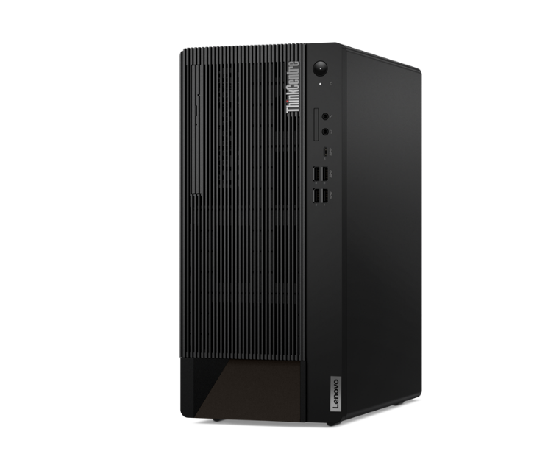
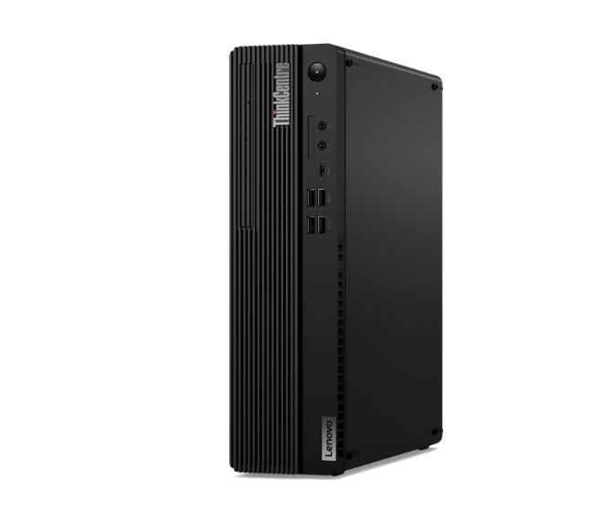
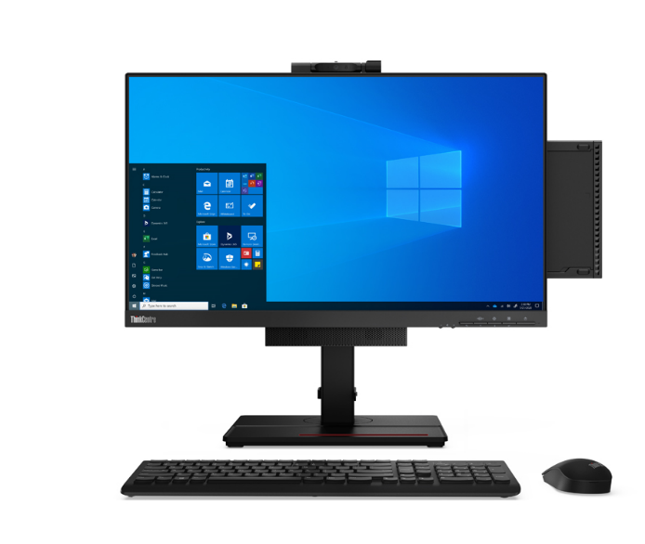
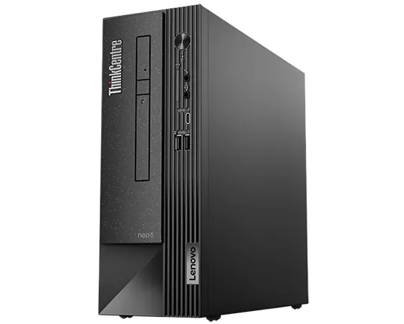
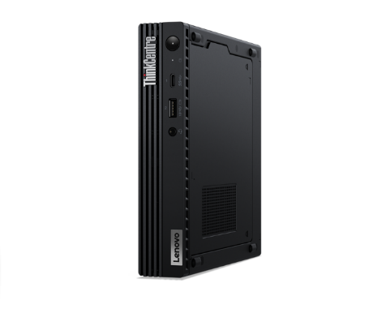
LENOVO TOPSELLER
ThinkCentre & Lenovo Desktops
[ 1 OF 6 ]
ThinkCentre M75q Gen 2 Tiny (Pictured with optional Tiny-in-One)
ThinkCentre Tower
(M70t/M80t/M90t)
ThinkCentre
Small Form Factor
(M70s/M75s/M80s/M90s)
ThinkCentre Neo Small Form Factor
(Neo50s)
ThinkCentre Tiny
(M60eM70q/M75q/M80q/M90q)

Slide 12
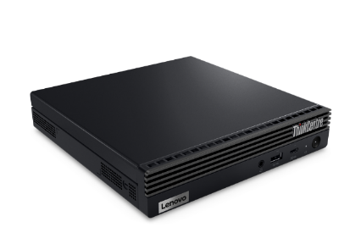

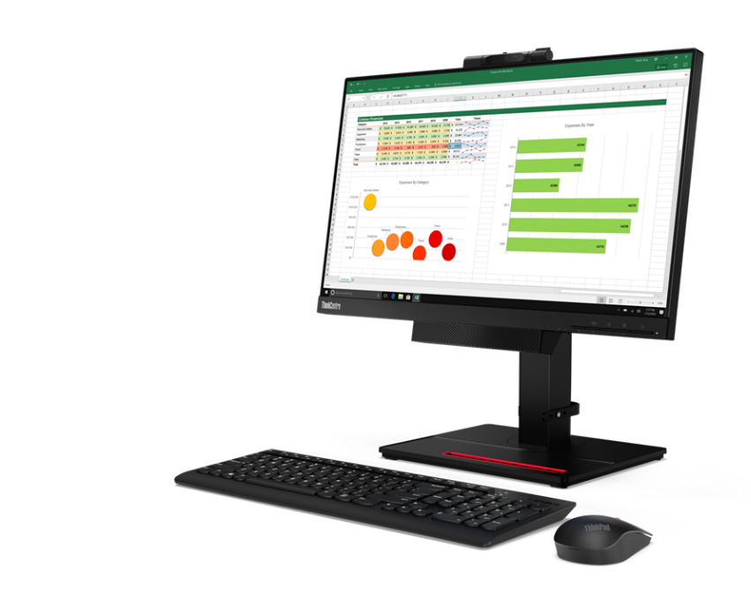
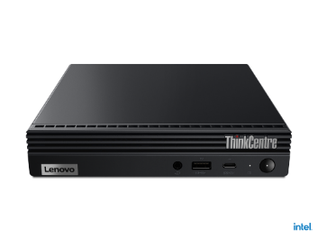
LENOVO TOPSELLER
ThinkCentre Tiny AMD & Intel Desktops
[ 2 OF 6 ]
M75q Tiny Gen 2 | $1029 | $1129 Rebate $50 | $1369
 | 11JN0074US | 11JN006RUS | 11JN0072US
 | 11JN007CCA | 11JN0076CA | 11JN007DCA
 | Ryzen 5 Pro 5650GE | Ryzen 5 Pro 5650GE | Ryzen 7 Pro 5750GE
 | 8GB Memory | 16GB Memory | 16GB Memory
 | 128GB SSD M.2 PCIe | 256GB SSD M.2 PCIe | 512GB SSD M.2 PCIe
 | Win11 Pro DG Win10 | Win11 Pro DG Win10 | Win11 Pro DG Win10
 | 3 Year Onsite | 3 Year Onsite | 3 Year Onsite
ThinkCentre M60e Tiny
[ 2 OF 3 ]
M60e Tiny | $699 | $739
 | 11LV0089US | 11LV009KUS
 | 11LV0089CA | 11LV009KCA
 | Core i5-1035G1 | Core i5-1035G1
 | 8GB Memory | 16GB Memory
 | 256GB M.2 SSD | 256GB M.2 SSD
 | 2x2 AC Wi-Fi + BT 5.2 | 2x2 AC Wi-Fi + BT 5.2
 | DP + HDMI | DP + HDMI
 | Win11 Pro | Win11 Pro
 | 1 Year Onsite | 1 Year Onsite
ThinkCentre M75q Tiny
(TIO monitor not included)

Slide 13
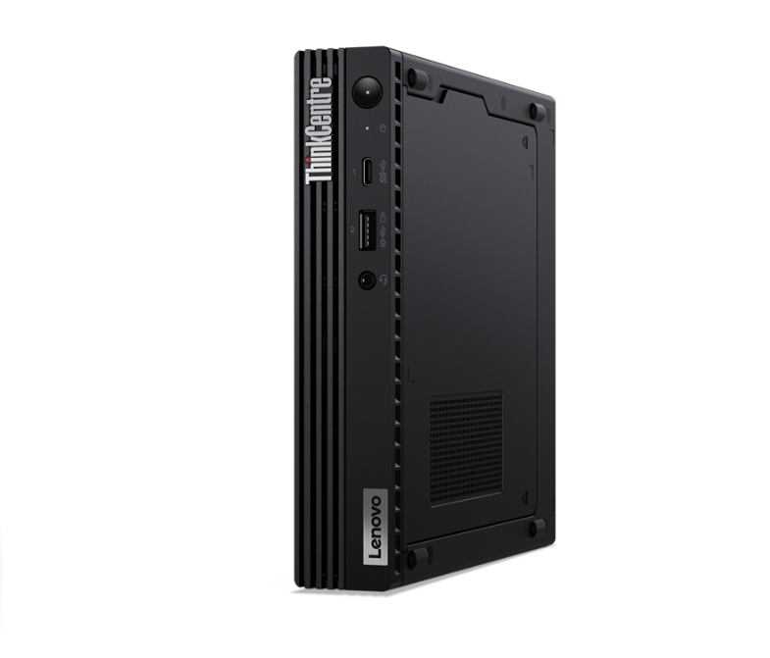
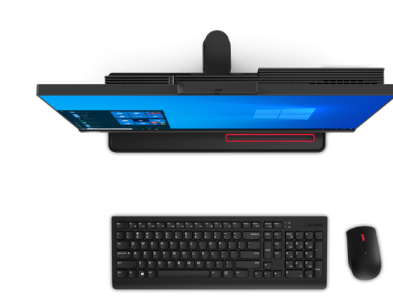
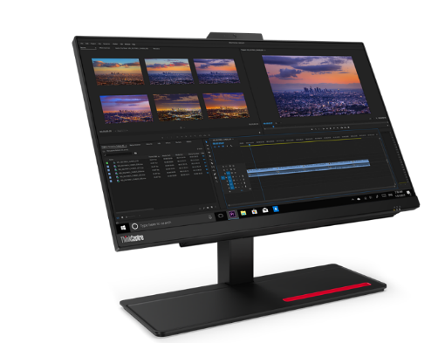
LENOVO TOPSELLER
ThinkCentre Adlerlake Tiny & AIO Desktops
[ 3 OF 6 ]
M70q Tiny Gen 3 | $1199 | $1259 | $1649 Rebate $60
 | 11T3008EUS | 11T300A4US | 11T30080US
 | 11T3008ECA | 11T300A4CA | 11T30080CA
 | Core i5-12400T | Core i5-12400T | Core i7-12700T
 | 8GB Memory | 16GB Memory | 16GB Memory
 | 256GB SSD M.2 PCIe | 256GB SSD M.2 PCIe | 512GB SSD M.2 PCIe
 | Win11 Pro DG Win10 | Win11 Pro DG Win10 | Win11 Pro DG Win10
 | 3 Year Onsite | 3 Year Onsite | 3 Year Onsite
M80q Tiny Gen 3 | $1339 | $1839
 | 11U1004XUS | 11U1004GUS
 | 11U1004XCA | 11U1004GCA
 | Core i5-12500T | Core i7-12700T
 | 16GB Memory | 16GB Memory
 | 256GB SSD M.2 PCIe | 512GB SSD M.2 PCIe
 | Win11 Pro DG Win10 | Win11 Pro DG Win10
 | 3 Year Onsite | 3 Year Onsite
M90q Tiny Gen 3 | $1579 | $2049
 | 11U50051US | 11U5005TUS
 | 11U50051CA | 11U5005TCA
 | Core i5-12500T | Core i7-12700T
 | 16GB Memory | 16GB Memory
 | 256GB SSD M.2 PCIe | 512GB SSD M.2 PCIe
 | Win11 Pro DG Win10 | Win11 Pro DG Win10
 | 3 Year Onsite | 3 Year Onsite
ThinkCentre M90q Tiny
[ 2 OF 3 ]
M70a All-in-One Gen 3 | $1809
 | 11VL003SUS
 | 11VL003SCA
 | 21.5” 1080p Multi-Touch Display
 | Core i5-12400
 | 8GB Memory
 | 256GB SSD M.2 PCIe NVMe Opal
 | DVD RW, Wi-Fi+BT, Webcam/Mic
 | DP Out, UltraFlex Stand
 | Win11 Pro
 | 3 Year Onsite
M90a All-in-One Gen 3 | $2009
 | 11VF0063US
 | 11VF0063CA
 | 23.8” 1080p Multi-Touch Display
 | Core i5-12500
 | 8GB Memory
 | 256GB M.2 PCIe SSD
 | DVD RW, Wi-Fi+BT, Webcam/Mic
 | DP Out, UltraFlex Stand
 | Win11 Pro DG Win10
 | 3 Year Onsite
M90a Pro AIO Gen 3 | $2169
 | 11VA004LUS
 | 11VA0057CA
 | 23.8” QHD-2560p Non-Touch Display
 | Core i5-12450
 | Memory
 | 512GB SSD M.2 PCIe NVMe Opal
 | DVD RW, Wi-Fi+BT, Webcam/Mic
 | DP Out, UltraFlex Stand
 | Win11 Pro DG Win10
 | 3 Year Onsite

Slide 14
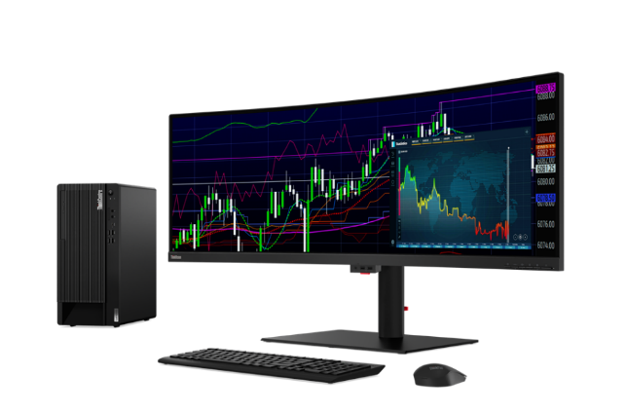
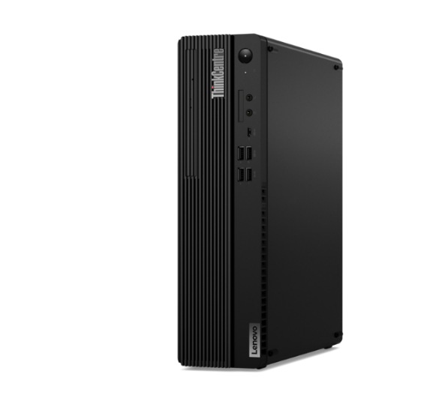
LENOVO TOPSELLER
ThinkCentre Small Form Factor Desktops
[ 4 OF 6 ]
M75s Gen 2 | $1089 | $1419
 | 11R80039US | 11R8003HUS
 | 11R80039CA | 11R8003HCA
 | Ryzen 5 Pro 5650G | Ryzen 7 Pro 5750G
 | 8GB Memory | 16GB Memory
 | 256GB SSD M.2 PCIe | 512GB SSD M.2 PCIe
 | DVD RW | DVD RW
 | 2 DisplayPort / 2 HDMI | 2 DisplayPort / 2 HDMI
 | Win11 Pro DG Win10 | Win11 Pro DG Win10
 | 3 Year Onsite | 3 Year Onsite
ThinkCentre M80s SFF
(monitor not included)
M70s Gen 3 | 1319 Rebate $45 | $1749
 | 11T8003CUS | 11T8002YUS
 | 11T8003FCA | 11T8002YCA
 | Core i5-12400 | Core i7-12700
 | 16GB Memory | 16GB Memory
 | 256GB SSD M.2 PCIe | 512GB SSD M.2 PCIe
 | DVD RW | DVD RW
 | 2 DisplayPort / 2 HDMI | 2 DisplayPort / 2 HDMI
 | Win11 Pro DG Win10 | Win11 Pro DG Win10
 | 3 Year Onsite | 3 Year Onsite
M80s Gen 3 | $1489 | $1859
 | 11TG001MUS | 11TG0020US
 | 11TG002QCA | 11TG002PCA
 | Core i5-12500 | Core i7-12700
 | 16GB Memory | 16GB Memory
 | 512GB SSD M.2 PCIe | 512GB SSD M.2 PCIe
 | DVD RW | DVD RW
 | 2 DisplayPort / 2 HDMI | 2 DisplayPort / 2 HDMI
 | Win11 Pro DG Win10 | Win11 Pro DG Win10
 | 3 Year Onsite | 3 Year Onsite

Slide 15

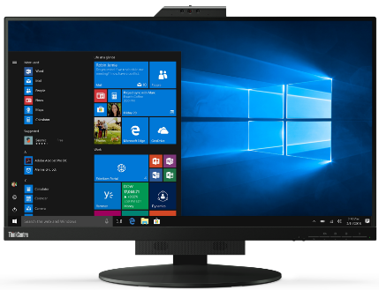




LENOVO TOPSELLER
ThinkCentre Tiny-in-One Monitors
[ 5 OF 6 ]
ThinkCentre Tiny-in-One 27
TINY-IN-ONE 4
Price is Monitor Only.
ThinkCentre Tiny (Pictured) Sold Separately
ThinkCentre Tiny-in-One 22
Tiny-in-One 22 Monitor | $396.44
 | 11GSPAR1US
 | 21.5” WLED Borderless Panel
 | 1080p Non-Touch Display
 | 720p Webcam w/ Dual Mic and ThinkShutter Cover
 | 1 x USB Type A port (Side)
 | Tiny PC Compatibility (AIO Mode)
 | DisplayPort In (Monitor Mode)
 | Lift / Tilt / Pivot Stand Adjustment
 | 3 Year Adv. Exchange Warranty
Tiny-in-One 24 Monitor | $428.24
 | 11GDPAR1US
 | 23.8” WLED Borderless Panel
 | 1080p Non-Touch Display
 | 1080p Webcam w/ Dual Mic
 | 1 x USB Type A port (Side)
 | Tiny PC Compatibility (AIO Mode)
 | DisplayPort In (Monitor Mode)
 | Lift / Tilt / Pivot Stand Adjustment
 | 3 Year Adv. Exchange Warranty
Tiny-in-One 27 Monitor | $608.44
 | 11JHRAR1US
 | 27” WLED Borderless Panel
 | 1440p Non-Touch Display
 | 1080p RGB/IR Webcam w/ Dual Mic
 | 2 x USB 3.1 port (Side)
 | Tiny PC Compatibility (AIO Mode)
 | DisplayPort / HMDI In (Monitor Mode)
 | Lift / Tilt / Pivot Stand Adjustment
 | 3 Year Adv. Exchange Warranty
Tiny-in-One 24 Touch Monitor | $523.64
 | 11GCPAR1US
 | 23.8” WLED Borderless Panel
 | 1080p Touch Display
 | 720p Webcam w/ Dual Mic
 | 1 x USB A port (Side)
 | Tiny PC Compatibility (AIO Mode)
 | DisplayPort In (Monitor Mode)
 | Lift / Tilt / Pivot Stand Adjustment
 | 3 Year Adv. Exchange Warranty

Slide 16


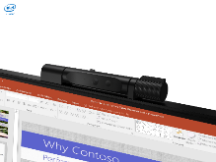
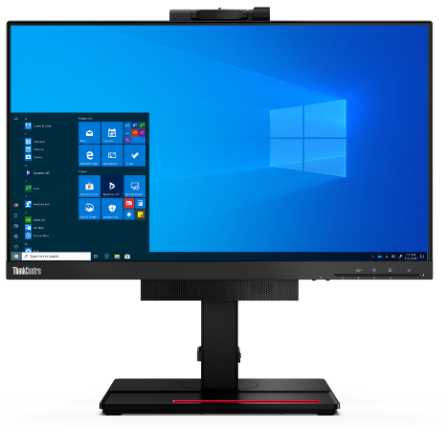
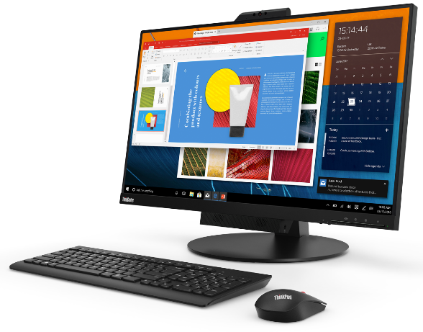
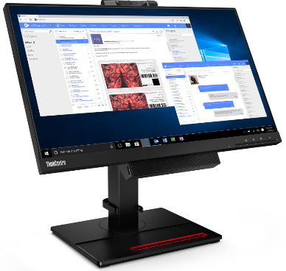
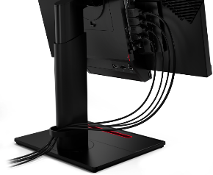


Tiny-In-One Series (Gen 4)
TIO4 22
TIO4 24
TIO 27
21.5” Widescreen Display
16:9 Aspect Ratio
Touch and Non-Touch Models Available
Integrated Webcam and Speakers
FHD (1920x1080) Resolution
Pairs with T22i-20
LTSP Stand
23.8” Widescreen Display
16:9 Aspect Ratio
Touch and Non-Touch Models Available
Integrated Webcam and Speakers
FHD (1920x1080) Resolution
Pairs with T24i-20
LTSP Stand
27” Widescreen Display
16:9 Aspect Ratio
Integrated RGBIR Camera
with ThinkShutter
QHD (2560x1440) Resolution
Pairs with T27h-20
LTSP Stand
2023 Lenovo Internal. All rights reserved.

Slide 17
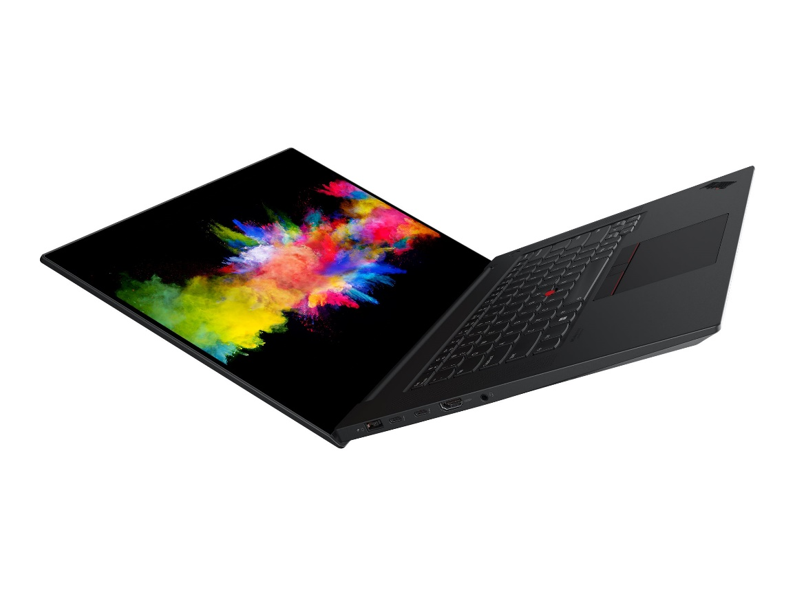
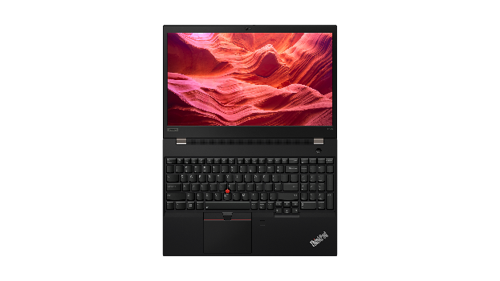
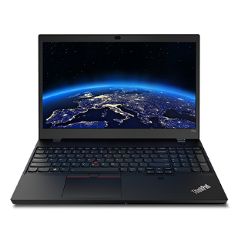
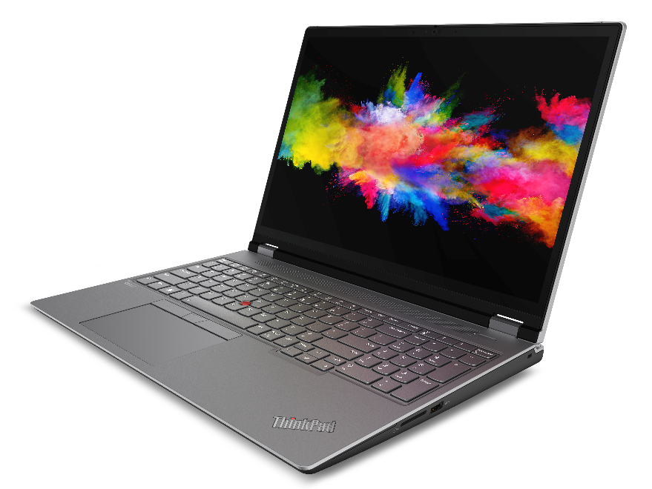
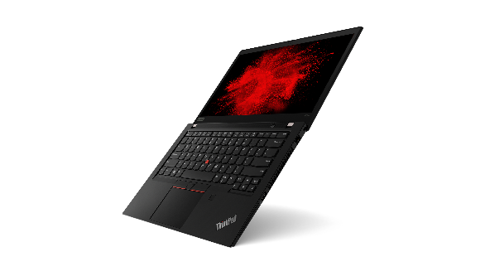
LENOVO TOPSELLER
ThinkPad Mobile Workstations
[ 1 OF 3 ]
P15v / T15p
P1
P16s Gen1 (Intel / AMD)
P14s Gen1 (Intel / AMD)
P16 Gen1

Slide 18
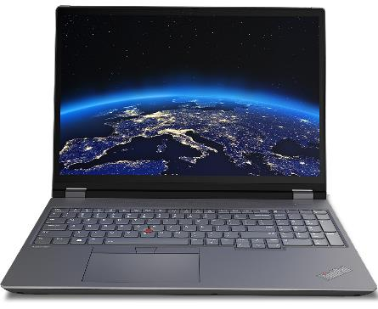
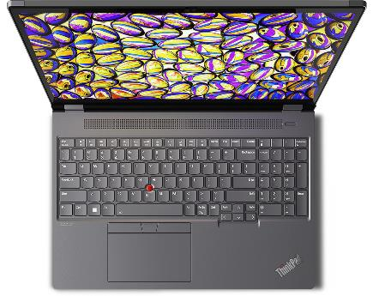
THINKPAD TOPSELLER
Mobile Workstations - Intel
[ 2 OF 3 ]
P1 Gen 5 | $3949 Rebate $100 | $4269 Rebate $100
 | 21DC003YUS | 21DC004JUS
 | 21DC003YCA | 21DC004JCA
 | Core i7-12800H | Core i7-12700H
 | 16GB DIMM | 2x 16GB DIMM
 | 512GB SSD NVMe | 1TB SSD NVMe
 | 16” WQXGA IPS Anti-glare, 100% sRGB | 16” WQXGA IPS Anti-glare, 100% sRGB
 | NVIDIA RTX A1000 | NVIDIA RTX A2000
 | IR Camera w/Shutter, FPR, 2x2 AX WLAN, BT, Backlit Keyboard | IR Camera w/Shutter, FPR, 2x2 AX WLAN, BT, Backlit Keyboard
 | Win11 Pro DG Win10 | Win11 Pro DG Win10
 | 3 Year Premier | 3 Year Premier
P16 Gen 1 | $3589 Rebate $200 | $4239 Rebate $200 | $4419
 | 21D6005MUS | 21D6005QUS | 21D6006PUS
 | 21D6005MCA | 21D6005QCA | 21D6006PCA
 | Core i7-12800HX | Core i7-12800HX | Core i7-12850HX
 | 2x 8GB DIMM | 2x 16GB DIMM | 2x 16GB DIMM
 | 512GB SSD NVMe | 1TB SSD NVMe | 1TB SSD NVMe
 | 16” WQXGA IPS Anti-glare, 100% sRGB | 16” WQXGA IPS Anti-glare, 100% sRGB | 16” WQXGA IPS Anti-glare, 100% sRGB
 | NVIDIA RTX A1000 | NVIDIA RTX A2000 | NVIDIA RTX A2000
 | IR Camera w/Shutter, FPR, 2x2 AX WLAN, BT, Backlit Keyboard | IR Camera w/Shutter, FPR, 2x2 AX WLAN, BT, Backlit Keyboard | IR Camera w/Shutter, FPR, 2x2 AX WLAN, BT, Backlit Keyboard
 | Win11 Pro DG Win10 | Win11 Pro DG Win10 | Win11 Pro DG Win10
 | 3 Year Premier | 3 Year Premier | 3 Year Premier
P16s Gen 1 - Intel | $2859 Rebate $200 | $3159 Rebate $200 | $3609 Rebate $200
 | 21BT001QUS | 21BT001GUS | 21BT001NUS
 | 21BT001QCA | 21BT001GCA | 21BT001NCA
 | Core i7-1260P | Core i7-1280P | Core i7-1280P
 | 16GB DIMM | 16GB DIMM | 2x 16GB DIMM
 | 512GB SSD NVMe | 512GB SSD NVMe | 1TB SSD NVMe
 | 16” WQXGA IPS Anti-glare | 16” WQXGA IPS Anti-glare | 16” WQXGA IPS Anti-glare
 | NVIDIA Quadro T550 | NVIDIA Quadro T550 | NVIDIA Quadro T550
 | IR Camera w/Shutter, FPR, 2x2 AX WLAN, BT, Backlit Keyboard | IR Camera w/Shutter, FPR, 2x2 AX WLAN, BT, Backlit Keyboard | IR Camera w/Shutter, FPR, 2x2 AX WLAN, BT, Backlit Keyboard
 | Win11 Pro | Win11 Pro | Win11 Pro
 | 3 Year Premier | 3 Year Premier | 3 Year Premier
P16 Gen1
P14s Gen 3 - Intel | $3129 Rebate $50 | $3359 Rebate $50
 | 21AK002HUS | 21AK0028US
 | 21AK002HCA | 21AK0028CA
 | Core i7-1280P | Core i7-1260P
 | 16GB DIMM | 2x 16GB DIMM
 | 512GB SSD NVMe | 1TB SSD NVMe
 | 14” WQXGA IPS Anti-glare | 14” WQXGA IPS Anti-glare
 | NVIDIA Quadro T550 | NVIDIA Quadro T550
 | IR Camera w/Shutter, FPR, 2x2 AX WLAN, BT, Backlit Keyboard | IR Camera w/Shutter, FPR, 2x2 AX WLAN, BT, Backlit Keyboard
 | Win11 Pro | Win11 Pro
 | 3 Year Premier | 3 Year Premier
P15v Gen 3 - Intel | $2879 Rebate $100 | $2979 Rebate $100 | $3809
 | 21D80033US | 21D8003HUS | 21D8004CUS
 | 21D80033CA | 21D8003HCA | 21D8004CCA
 | Core i7-12700H | Core i7-12700H | Core i7-12800H
 | 16GB DIMM | 16GB DIMM | 2x 16GB DIMM
 | 512GB SSD NVMe | 512GB SSD NVMe | 1TB SSD NVMe
 | 15.6” FHD IPS Anti-glare | 15.6” FHD IPS Anti-glare | 15.6” FHD IPS Anti-glare
 | NVIDIA T600 | NVIDIA T1200 | NVIDIA RTX A2000
 | IR Camera w/Shutter, FPR, 2x2 AX WLAN, BT, Backlit Keyboard | IR Camera w/Shutter, FPR, 2x2 AX WLAN, BT, Backlit Keyboard | IR Camera w/Shutter, FPR, 2x2 AX WLAN, BT, Backlit Keyboard
 | Win11 Pro DG Win10 | Win11 Pro DG Win10 | Win11 Pro DG Win10
 | 3 Year Premier | 3 Year Premier | 3 Year Premier
T15p Gen 3 | $2939 | $3579
 | 21DA0010US | 21DA000XUS
 | 21DA0010CA | 21DA000XCA
 | Core i7-12700H | Core i7-12700H
 | 16GB DIMM | 2x 16GB DIMM
 | 512GB SSD NVMe | 1TB SSD NVMe
 | 15.6” FHD IPS Anti-glare | 15.6” UHD IPS Anti-glare, 100% sRGB
 | NVIDIA GeForce RTX 3050 | NVIDIA GeForce RTX 3050
 | IR Camera w/Shutter, FPR, 2x2 AX WLAN, BT, Backlit Keyboard | IR Camera w/Shutter, FPR, 2x2 AX WLAN, BT, Backlit Keyboard
 | Win11 Pro DG Win10 | Win11 Pro DG Win10
 | 3 Year Premier | 3 Year Premier
P16s Gen1

Slide 19
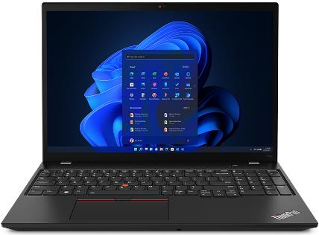
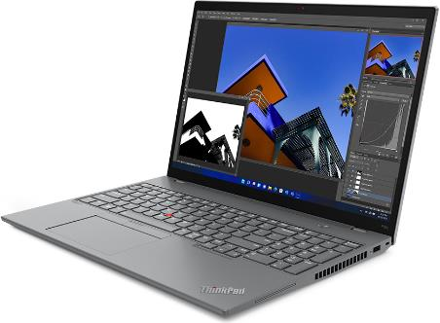
THINKPAD TOPSELLER
Mobile Workstations - AMD
[ 3 OF 3 ]
P16s Gen 1 - AMD | $2619 Rebate $250 | $2789 Rebate $250
 | 21CK001MUS | 21CK001PUS
 | Ryzen 7 PRO 6850U | Ryzen 7 PRO 6850U
 | 16GB DIMM | 32GB DIMM
 | 512GB SSD NVMe | 512GB SSD NVMe
 | 16” WQXGA IPS Anti-glare | 16” WQXGA IPS Anti-glare
 | Integrated AMD Radeon 680M | Integrated AMD Radeon 680M
 | IR Camera w/Shutter, FPR, 2x2 AX WLAN, BT, Backlit Keyboard | IR Camera w/Shutter, FPR, 2x2 AX WLAN, BT, Backlit Keyboard
 | Win11 Pro DG Win10 | Win11 Pro DG Win10
 | 3 Year Premier | 3 Year Premier
P14s Gen 3 - AMD | $2509 Rebate $100 | $2789 Rebate $100
 | 21J5001LUS | 21J5001VUS
 | 21J5001LCA | 21J5001VCA
 | Ryzen 7 PRO 6850U | Ryzen 7 PRO 6850U
 | 16GB DIMM | 32GB DIMM
 | 512GB SSD NVMe | 512GB SSD NVMe
 | 14” WQXGA IPS Anti-glare | 14” WQXGA IPS Anti-glare Touch
 | Integrated AMD Radeon 680M | Integrated AMD Radeon 680M
 | IR Camera w/Shutter, FPR, 2x2 AX WLAN, BT, Backlit Keyboard | IR Camera w/Shutter, FPR, 2x2 AX WLAN, BT, Backlit Keyboard
 | Win11 Pro DG Win10 | Win11 Pro DG Win10
 | 3 Year Premier | 3 Year Premier
P15v Gen1
P15v Gen 1 - AMD | $2569 Rebate $100 | $3449 Rebate $100
 | 21EM001JUS | 21EM001NUS
 | 21EM001JCA | 21EM001NCA
 | Ryzen 5 PRO 6650H | Ryzen 7 PRO 6850H
 | 16GB DIMM | 2x 16GB DIMM
 | 512GB SSD NVMe | 1TB SSD NVMe
 | 15.6” FHD IPS Anti-glare | 15.6” FHD IPS Anti-glare
 | NVIDIA T600 | NVIDIA RTX A2000
 | IR Camera w/Shutter, FPR, 2x2 AX WLAN, BT, Backlit Keyboard | IR Camera w/Shutter, FPR, 2x2 AX WLAN, BT, Backlit Keyboard
 | Win11 Pro DG Win10 | Win11 Pro DG Win10
 | 3 Year Premier | 3 Year Premier
P14s Gen3
P16s Gen1

Slide 20
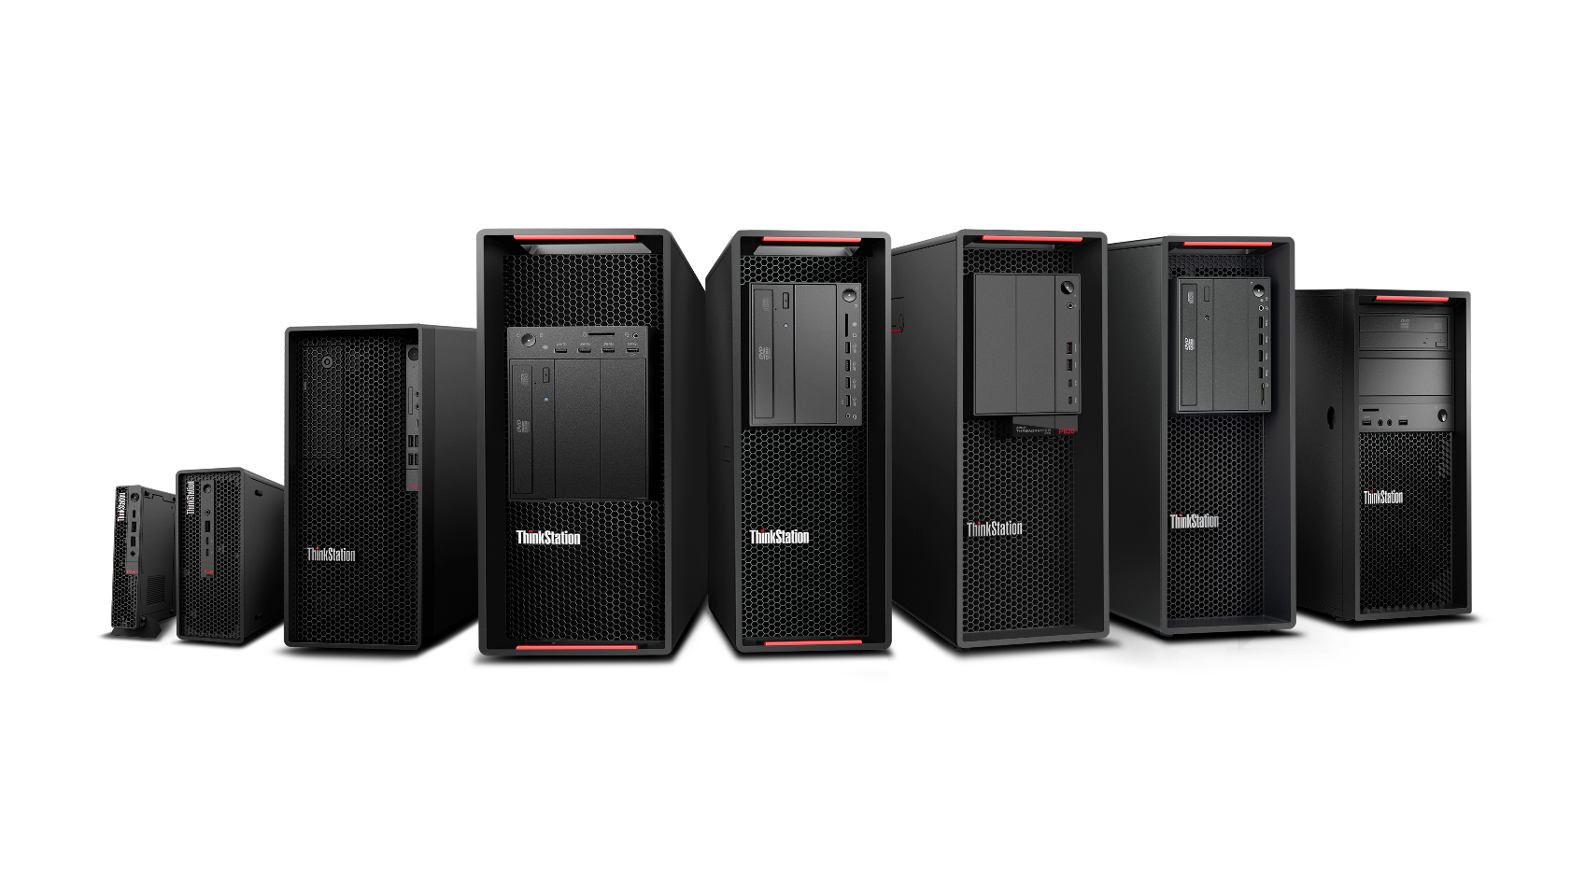
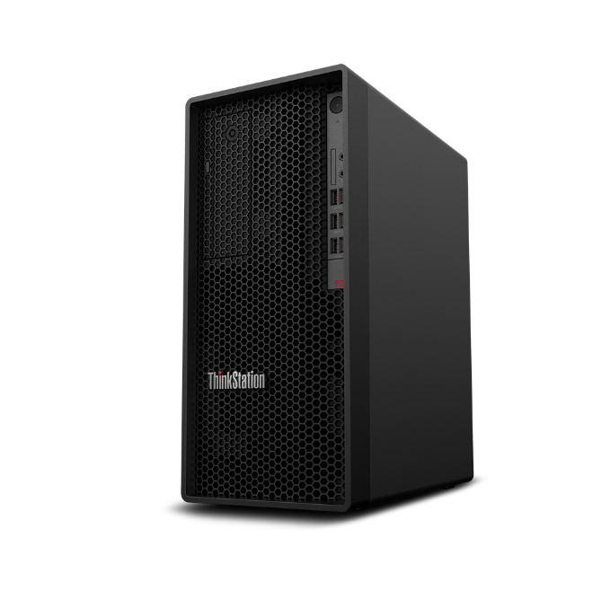
THINKSTATION TOPSELLER
Desktop Workstations
[ 1 OF 3 ]
P360 Ultra
REDEFIGNING THE POWER OF SMALL
P920
MOST
ADVANCED
DUAL-PROCESSOR WORKSTATION
P720
PROFESSIONAL POWER WITH ULTIMATE
VERSATILITY
P520
THE MOST
POWERFUL
SINGLE CPU WORKSTATION
P360 Tower
POWER OF A WORKSTATION,
PRICE OF A
DESKTOP
P360 Tiny
WORLD’S SMALLEST WORKSTATION
P620
LIMITLESS
POSSIBILITIES
P520c
HIGH
PERFORMANCE WITHOUT THE HIGH PRICE
P348 (Intel) / P358 (AMD) Tower
SUB-ENTRY WORKSTATION

Slide 21
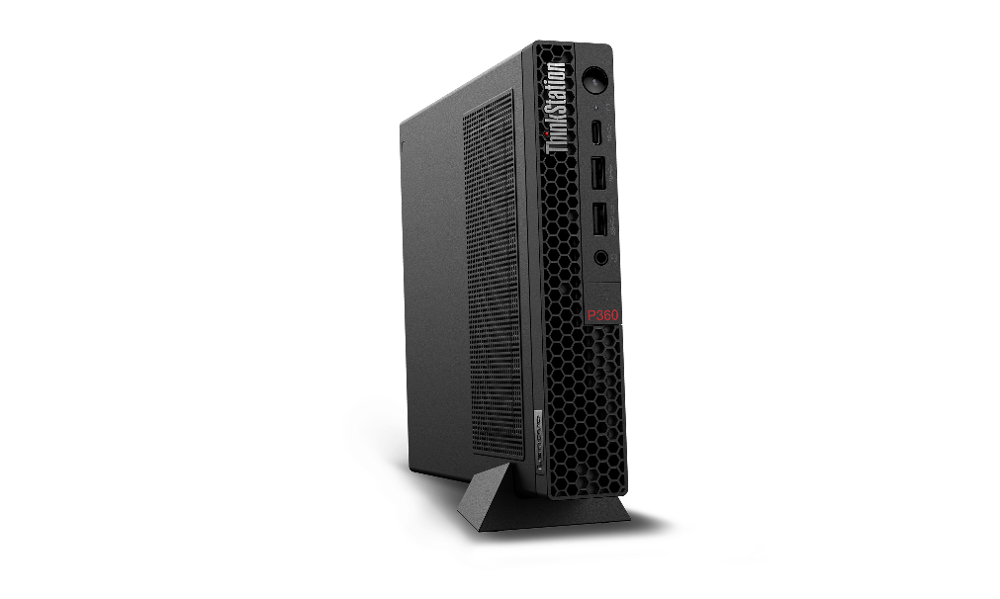
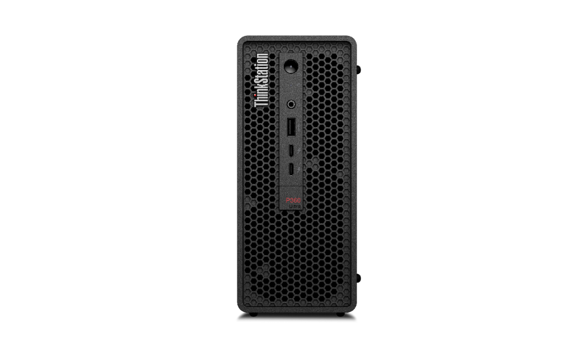
THINKSTATION TOPSELLER
Desktop Workstations
[ 2 OF 3 ]
P360 Tiny | $1559 | $2099 | $2849 | $3199
 | 30FA001CUS | 30FA001EUS | 30FA001BUS | 30FA005SUS
 | 30FA001CCA | 30FA001ECA | 30FA001BCA | 30FA005SCA
 | Core i7-12500T | Core i7-12700T | Core i7-12700T | Core i9-12900T
 | 16GB Memory | 16GB Memory | 32GB Memory | 32GB Memory
 | 512GB SSD M.2 PCIe | 512GB SSD M.2 PCIe | 1TB SSD M.2 PCIe | 1TB SSD M.2 PCIe
 | Integrated Graphics | NVIDIA T400 4GB | NVIDIA T1000 | NVIDIA T1000
 | Win11 Pro | Win11 Pro | Win11 Pro | Win11 Pro DG Win10
 | 3 Year Onsite Premier | 3 Year Onsite Premier | 3 Year Onsite Premier | 3 Year Onsite Premier
P360 Ultra | $2369 | $2489 Rebate $100 | $3599 Rebate $100 | $3999
 | 30G1001AUS | 30G1000LUS | 30G1000KUS | 30G1001DUS
 | 30G1001ACA | 30G1000LCA | 30G1000KCA | 30G1001DCA
 | Core i7-12700 | Core i5-12600 | Core i7-12700 | Core i9-12900
 | 16GB Memory | 16GB Memory | 32GB Memory | 32GB Memory
 | 512GB SSD M.2 PCIe | 512GB SSD M.2 PCIe | 1TB SSD M.2 PCIe | 1TB SSD M.2 PCIe
 | NVIDIA T400 | NVIDIA T1000 | NVIDIA RTX A2000 | NVIDIA RTX A2000
 | Win11 Pro | Win11 Pro | Win11 Pro | Win11 Pro
 | 3 Year Onsite Premier | 3 Year Onsite Premier | 3 Year Onsite Premier | 3 Year Onsite Premier
P360 Tiny
P360 Tower | $1699 Rebate $100 | $2849 Rebate $100 | $4129 Rebate $100
 | 30FM0017US | 30FM0018US | 30FM0015US
 | 30FM0017CA | 30FM0018CA | 30FM0015CA
 | Core i5-12500 | Core i9-12900K | Core i7-12700
 | 16GB Memory | 32GB Memory | 32GB Memory
 | 512GB SSD M.2 PCIe | 1TB SSD M.2 PCIe | 1TB SSD M.2 PCIe
 | Integrated Graphics | Integrated Graphics | NVIDIA RTX A4000
 | Win11 Pro | Win11 Pro | Win11 Pro
 | 3 Year Onsite Premier | 3 Year Onsite Premier | 3 Year Onsite Premier
P358 Tower – AMD | $2499 | $3319
 | 30GL0052US | 30GL0051US
 | 30GL0052CA | 30GL0051CA
 | Ryzen 7 PRO 5845 | Ryzen 9 PRO 5945
 | 16GB Memory | 32GB Memory
 | 512GB SSD M.2 PCIe | 1TB SSD M.2 PCIe
 | NVIDIA RTX 3060 | NVIDIA RTX 3060
 | Win11 Pro | Win11 Pro
 | 3 Year Onsite Premier | 3 Year Onsite Premier
P360 Ultra

Slide 22

THINKSTATION TOPSELLER
Desktop Workstations
[ 3 OF 3 ]
P5 | $4589 | $5589 | $11329
 | 30GA0014US | 30GA000UUS | 30GA0013US
 | 30GA0014CA | 30GA000UCA | 30GA0013CA
 | Intel Xeon w3-2425 | Intel Xeon w3-2435 | Intel Xeon w5-2445
 | 32GB Memory | 32GB Memory | 32GB Memory
 | 512GB SSD M.2 PCIe | 1TB SSD M.2 PCIe | 1TB SSD M.2 PCIe
 | NVIDIA T1000 | NVIDIA RTX A2000 | NVIDIA RTX A5500
 | Win11 Pro | Win11 Pro | Win11 Pro
 | 3 Year Onsite Premier | 3 Year Onsite Premier | 3 Year Onsite Premier
P620 | $4159 Rebate $600 | $6809 Rebate $1000
 | 30E000M9US | 30E000MRUS
 | Ryzen Threadripper PRO 5945WX | AMD Ryzen Threadripper PRO 5955WX
 | 2x 16GB Memory | 4x 16GB Memory
 | 1TB SSD M.2 PCIe | 2TB SSD M.2 PCIe
 | NVIDIA T400 | NVIDIA RTX A2000
 | Win11 Pro | Win11 Pro
 | 3 Year Onsite Premier | 3 Year Onsite Premier
P5 Workstation

Slide 23
DTWS GPU Comparison Table
THINKSTATION TOPSELLER
Desktop Workstations
[ 1 OF 1 ]
GPU Model | Architecture | Frame Buffer Size or VRAM | Memory Type | Memory Interface | CUDA Cores / Stream Processors | RT Cores | Tensor Cores | VR Ready | Offered on
NVIDIA T400(miniDP x3) - 2GB GDDR6 | Turing | 2GB | GDDR6 | 64-bit | 384 | N/A | N/A |  | P360 TWR,P350TWR/SFF, P340TWR/SFF,P348, P520, P520c, P720, P920
NVIDIA T400(miniDP x3) - 4GB GDDR6 | Turing | 4GB | GDDR6 | 64-bit | 384 | N/A | N/A |  | P360 TWR, P350TWR/SFF, P340TWR/SFF, P348, P358, P360 Tiny, P360 Ultra, P520, P520c, P620, P720, P920
NVIDIA T600(miniDP x4) - 4GB GDDR6 | Turing | 4GB | GDDR6 | 128-bit | 640 | N/A | N/A |  | P360 TWR,P350TWR/SFF, P340TWR/SFF,P348, P350 Tiny, P360 Tiny, P520, P520c, P620, P720, P920
NVIDIA Quadro T1000(miniDP x4) - 4GB GDDR6 | Turing | 4GB | GDDR6 | 128-bit | 896 | N/A | N/A |  | P360 TWR, P350 TWR/SFF, P340TWR/SFF, P348, P350 Tiny, P360 Tiny, P520, P520c, P620, P720, P920
NVIDIA Quadro T1000(miniDP x4) - 8GB GDDR6 | Turing | 8GB | GDDR6 | 128-bit | 896 | N/A | N/A |  | P360 TWR, P350 TWR/SFF, P340 TWR/SFF, P348, P358, P340 Tiny, P350 Tiny, P360 Tiny, P360 Ultra, P520, P520c, P620, P720, P920
NVIDIA Quadro A2000(DP x4) - 6GB GDDR6 | Ampere | 6GB | GDDR6 | 192-bit | 3,328 | 26 | 104 | X | P360 TWR, P350 TWR/SFF, P340TWR, P520, P520c, P620, P720, P920
NVIDIA Quadro A2000(DP x4) - 12GB GDDR6 | Ampere | 12GB | GDDR6 | 192-bit | 3,328 | 26 | 104 | X | P360 TWR, P350TWR/SFF, P340 TWR, P358, P360 Ultra, P520, P520c, P620, P720, P920
NVIDIA Quadro A4000(DP x4) - 16GB GDDR6 | Ampere | 16GB | GDDR6 | 256-bit | 6,144 | 48 | 192 | X | P360 TWR, P350 TWR, P520, P520c, P620, P720, P920
NVIDIA Quadro RTX A4500(DP x4) - 24GB GDDR6 | Ampere | 24GB | GDDR6 | 320-bit | 7,168 | 56 | 224 | X | P360 TWR, P520, P520c, P620, P720, P920
Nvidia RTX A5000 mobile,16GB, 4miniDP,GDDR6 | Ampere | 16GB | GDDR6 | 256-bit | 6,144 | 48 | 192 | X | P360 Ultra
NVIDIA Quadro RTX A5000(DP x4) - 24GB GDDR6 | Ampere | 24GB | GDDR6 | 384-bit | 10,240 | 64 | 256 | X | P360 TWR, P350 TWR, P520, P520c, P620, P720, P920
NVIDIA Quadro RTX A5500(DP x4) - 24GB GDDR6 | Ampere | 24GB | GDDR6 | 384-bit | 10,240 | 80 | 320 | X | P520, P520c, P620, P720, P920
NVIDIA Quadro RTX A6000(DP x4) - 24GB GDDR6 | Ampere | 48GB | GDDR6 | 384-bit | 10,752 | 84 | 336 | X | P520, P520c, P620, P720, P920
NVIDIA GeForce GTX1660 Super(1xDP,1xHDMI,1xDVI-D) - 6GB GDDR6 | Turing | 4GB | GDDR6 | 128-bit | 1,408 | N/A | N/A | X | P340 TWR, P348
NVIDIA Geforce RTX 3060(DP x3, HDMI x1) - 12GB GDDR6X | Ampere | 8GB | GDDR6 | 192-bit | 3,584 | 38 | 152 | X | P360 TWR, P350 TWR, P348, P358
NVIDIA Geforce RTX 3060Ti(DP x3, HDMI x1) - 8GB GDDR6X | Ampere | 8GB | GDDR6X | 256-bit | 4,864 | 38 | 152 | X | P520, P520c, P620,
NVIDIA Geforce RTX 3070Ti(DP x3, HDMI x1) - 8GB GDDR6X | Ampere | 8GB | GDDR6X | 256-bit | 6,144 | 48 | 192 | X | P360 TWR, P358, P520, P520c, P620, P720
NVIDIA GeForce RTX 3080(DPx3, HDMIx1) - 10GB DDR6X | Ampere | 10GB | GDDR6X | 320-bit | 8,704 | 68 | 272 | X | P360 TWR, P358, P520, P620, P720
NVIDIA GeForce RTX 3080Ti (DPx3, HDMIx1) - 10GB DDR6X | Ampere | 12GB | GDDR6X | 320-bit | 10,240 | 80 | 320 | X | P520, P620
AMD Radeon Pro WX3200 (MiniDP x 4) 4GB DDR5 HP | Polaris | 4GB | GDDR5 | 128-bit | 640 | 12 | N/A |  | P350 TWR/SFF,P340TWR/SFF,P348, P360 Ultra
AMD Radeon Pro W6400 (DP x 2) 4GB DDR6 | RDNA 2 | 4GB | GDDR6 | 64-bit | 768 | 12 | N/A |  | P620, P358 Ref2.0, P360Tower Ref2.0
AMD Radeon Pro W6600 (DP x 4) 8GB DDR6 | RDNA 2 | 8GB | GDDR6 | 128-bit | 1792 | 28 | N/A |  | P620
AMD Radeon Pro W6800 (mDP x 6) 32GB DDR6 | RDNA 2 | 32GB | GDDR6 | 256-bit | 3840 | 60 | N/A |  | P620
Intel® UHD Graphics 770 | 770 | N/A | UDIMM ECC/No-ECC, DPC DDR4 @ 1.2V | 256-bit | N/A | N/A | N/A |  | P360 TWR, P360 Ultra, P360 Tiny

Slide 24




Attach and Upgrade Options for Workstations
THINKSTATION TOPSELLER
Desktop Workstations
[ 1 OF 1 ]
Prices shown do not include rebate (if available).
Attach Performance Displays – Lenovo’s Best!
24” | $459 P24q-20 61F5GAR1US 23.8-inch QHD No USB-C Daisy chain capable | $559 P24h-2L 62B2GAR1US 23.8-inch QHD 2560x1440 USB-C (up to 70w) Daisy chain capable
27” | $576 P27q-20 61EAGAR6US 27-inch QHD 4-sided near-edgeless 2560x1440 Daisy chain capable | $724 P27h-20 61E9GAR6US 27-inch QHD 4-sided near-edgeless USB-C (90W) Integrated RJ45 Daisy chain capable
32” | $1,484 P32p-20 62A2GAR2US 32-inch 4K UHD USB-C (up 90W) Integrated RJ45 Integrated phone holder stand
P340 SFF | P340 TWR | P350 SFF | P350 TWR | P348 TWR | P358 TWR
$201.99 - 4X60N86656 NVIDIA Quadro P400 2GB $359.99 - 4X60R60469 NVIDIA Quadro P620 2GB $604.99 - 4X60N86660 NVIDIA Quadro P1000 4GB $229.99 - 4X61J52234 NVIDIA T400 4GB $599.99 - 4X61J52233 NVIDIA T1000 8GB | $499.99 - 4X61E26088 NVIDIA T1000 4GB $229.99 - 4X61J52234 NVIDIA T400 4GB $599.99 - 4X61J52233 NVIDIA T1000 8GB $1,049.99 - 4X61J52232 NVIDIA RTX A2000 12GB $1,749.99 - 4X61E26089 NVIDIA A4000 16GB | $297.99 - 4X61H02424 NVIDIA T600 4GB $229.99 - 4X61J52234 NVIDIA T400 4GB $599.99 - 4X61J52233 NVIDIA T1000 8GB $1,049.99 - 4X61J52232 NVIDIA RTX A2000 12GB | $179.99 - 4X61F99432 NVIDIA T400 2GB $299.99 - 4X61E26090 NVIDIA T1000 4GB $699.99 - 4X61F99433 NVIDIA RTX A2000 6GB $229.99 - 4X61J52234 NVIDIA T400 4GB $599.99 - 4X61J52233 NVIDIA T1000 8GB $1,049.99 - 4X61J52232 NVIDIA RTX A2000 12GB $1,749.99 - 4X61E26089 NVIDIA A4000 16GB $3,499.99 - 4X61D97085 NVIDIA A5000 24GB | $179.99 - 4X61F99432 NVIDIA T400 2GB $299.99 - 4X61E26090 NVIDIA T600 4GB $499.99 - 4X61E26088 NVIDIA T1000 4GB
P360 Ultra | P360 TWR | P520c | P520 | P620 | P720/P920
$229.99 - 4X61J52234 NVIDIA T400 4GB $599.99 - 4X61J52233 NVIDIA T1000 8GB $1,049.99 - 4X61J52232 NVIDIA RTX A2000 12GB | $179.99 - 4X61F99432 NVIDIA T400 2GB $299.99 - 4X61E26090 NVIDIA T600 4GB $499.99 - 4X61E26088 NVIDIA T1000 4GB $699.99 - 4X61F99433 NVIDIA RTX A2000 6GB $229.99 - 4X61J52234 NVIDIA T400 4GB $599.99 - 4X61J52233 NVIDIA T1000 8GB $1,049.99 - 4X61J52232 NVIDIA RTX A2000 12GB $1,749.99 - 4X61E26089 NVIDIA A4000 16GB $2,599.99 - 4X61J77360 NVIDIA A4500 20GB $3,499.99 - 4X61D97085 NVIDIA A5000 24GB | $604.99 - 4X60N86661 NVIDIA Quadro P1000 4GB $169.99 - 4X61F99432 NVIDIA T400 2GB $299.99 - 4X61E26090 NVIDIA T600 4GB $499.99 - 4X61E26088 NVIDIA T1000 4GB $229.99 - 4X61J52234 NVIDIA T400 4GB $1,049.99 - 4X61J52232 NVIDIA RTX A2000 12GB $1,749.99 - 4X61E26089 NVIDIA A4000 16GB $2,599.99 - 4X61J77360 NVIDIA A4500 20GB $3,499.99 - 4X61D97085 NVIDIA A5000 24GB | $179.99 - 4X61F99432 NVIDIA T400 2GB $299.99 - 4X61E26090 NVIDIA T600 4GB $499.99 - 4X61E26088 NVIDIA T1000 4GB $699.99 - 4X61F99433 NVIDIA RTX A2000 6GB $229.99 - 4X61J52234 NVIDIA T400 4GB $599.99 - 4X61J52233 NVIDIA T1000 8GB $1,049.99 - 4X61J52232 NVIDIA RTX A2000 12GB $1,749.99 - 4X61E26089 NVIDIA A4000 16GB $2,599.99 - 4X61J77360 NVIDIA A4500 20GB $3,499.99 - 4X61D97085 NVIDIA A5000 24GB $7,919.99 - 4X61D17227 NVIDIA A6000 48GB | $359.99 - 4X60R60468 NVIDIA Quadro P620 2GB $604.99 - 4X60N86661 NVIDIA Quadro P1000 4GB $299.99 - 4X61E26090 NVIDIA T600 4GB $499.99 - 4X61E26088 NVIDIA T1000 4GB $1,749.99 - 4X61E26089 NVIDIA A4000 16GB $3,499.99 - 4X61D97085 NVIDIA A5000 24GB $7,919.99 - 4X61D17227 NVIDIA A6000 48GB | $186.99 - 4X60N86657 NVIDIA Quadro P400 2GB $359.99 - 4X60R60468 NVIDIA Quadro P1000 4GB $179.99 - 4X61F99432 NVIDIA T400 2GB $299.99 - 4X61E26090 NVIDIA T600 4GB $499.99 - 4X61E26088 NVIDIA T1000 4GB $699.99 - 4X61F99433 NVIDIA RTX A2000 6GB $229.99 - 4X61J52234 NVIDIA T400 4GB $599.99 - 4X61J52233 NVIDIA T1000 8GB $1,049.99 - 4X61J52232 NVIDIA RTX A2000 12GB $1,749.99 - 4X61E26089 NVIDIA A4000 16GB $2,599.99 - 4X61J77360 NVIDIA A4500 20GB $3,499.99 - 4X61D97085 NVIDIA A5000 24GB $7,919.99 - 4X61D17227 NVIDIA A6000 48GB

Slide 25









P Series
Premium Performance
Portfolio
T Series
TIO Series
Mainstream Productivity
Modular AIO
M Series
Mobile Productivity
E Series
Entry Productivity
S Series
SMB

Slide 26


ThinkVision P Series
P24q-20 | P24h-2L
23.8” 16:9 Display QHD 2560x1440 DP/HDMI Daisy Chain $459 MTM: 61F5GAR1US | 23.8” 16:9 nLBL Display QHD 2560x1440 USB-C (75W) / DP 1.2 / HDMI Daisy Chain Docking Monitor w/RJ45 Ethernet $559 MTM: 62B2GAR1US
P24q-30 | P24h-30
23.8” 16:9 nLBL Display QHD 2560x1440 DP/HDMI Daisy Chain $487 MTM: 63B4GAR6US | 23.8” 16:9 nLBL Display QHD 2560x1440 USB-C (100W) / DP 1.4 / HDMI Daisy Chain Docking Monitor w/RJ45 Ethernet $571 MTM: 63B3GAR6US
23.8”
2023 Lenovo Internal. All rights reserved.

Slide 27





ThinkVision T86, T75, T65
Interactive Large Format Displays (iLFDs)
Specs
All Models
  Wireless Projection (via W30 wireless dongle)
  Whiteboard / 20 pt IR Touch Functionality
  Remote Collaboration
  3840x2160 4K Resolution
  Android 9 OS
  4K AI Enhanced Smart Camera*
  Front Ports: HDMI2.0(1), USB 3.0(1), USB-C(1), USB touch(1)
  Other Ports: USB-C(1), HDMI2.0(3), DP1.2(1), VGA(1), USB3.0(2), USB touch(1), RJ45(2), RS232(1), HDMI out(1), Audio out/in(1)
  Ambient light & Human presence sensors
  2x 15W speakers & 8-array microphone
T65 no Camera | T75 w/ 4K Camera | T86 w/ 4K Camera
65” Touchscreen Display $6,399 MTM: 62F3KATCWW | 75” Touchscreen Display $7,679 MTM: 62F4KATCWW | 85” Touchscreen Display $10,239 MTM: 62F0KATAWW
* 4K Camera only on T75 & T86 models

Slide 28





ThinkVision T Series
T27i-30
27” 16:9 Display FHD 1920x1080 DP/HDMI/VGA $423 MTM: 63A4MAR1US
T27h-20 | T27h-2L
27” 16:9 Display QHD 2560x1440 USB-C (75W) $576 MTM: 61ECGAR2US | 27” 16:9 nLBL Display QHD 2560x1440 USB-C (75W) $519 MTM: 62B1GAR2US
27”
T22i-30 (Channel Only) | T23i-30 (Channel Only) | T24i-30 (Channel Only)
21.5” 16:9 Display FHD 1920x1080 DP/HDMI/VGA $219 MTM: 63B0MAT6US | 23” 16:9 Display FHD 1920x1080 DP/HDMI/VGA $249 MTM: 63B2MAT6US | 23.8” 16:9 Display FHD 1920x1080 DP/HDMI/VGA $239 MTM: 63CFMAT1US
21.5” – 23.8”
T23d-10
22.5” 16:10 Display FHD 1920x1080 DP/HDMI/VGA $352 MTM: 61C3MAR6US
T22i-20 (Channel Only) | T23i-20 (Channel Only) | T24i-20 (Channel Only)
21.5” 16:9 Display FHD 1920x1080 DP/HDMI/VGA $260 MTM: 61FEMAT6US | 23” 16:9 Display FHD 1920x1080 DP/HDMI/VGA $300 MTM: 61F6MAT2US | 23.8” 16:9 Display FHD 1920x1080 DP/HDMI/VGA $280 MTM: 61F7MAT1US
2023 Lenovo Internal. All rights reserved.

Slide 29


ThinkVision M Series Mobile Monitors
M15
15.6” FHD 1920x1080 16:9 Display 45% sRGB Color $296 MTM: 62CAUAR1US
M14
14” FHD 1920x1080 16:9 Display 72% sRGB Color $428 MTM: 61DDUAR6US
15.6” FHD
14” FHD
M14
2023 Lenovo Internal. All rights reserved.
M15

Slide 30









E Series
E27q-20
$455
MTM: 62D0GAR1US
E28u-20
$529
MTM: 62F9GAR4US
E29w-20
$406
MTM: 62CEGAR3US
27” Widescreen Display
27” IPS Screen
2560x1440 FHD Resolution
HDMI, & DP Video Inputs
Lift, Tilt, Pivot Stand
Integrated Speakers (2x 2W)
VESA Mount
28” Widescreen Display
28” IPS Screen
3840x2160 FHD Resolution
DP & HDMI Video Inputs
Lift, Tilt, Pivot Stand
VESA Mount
29” Widescreen Display
23.8” IPS Screen
2560 x 1080 FHD Resolution (75 Hz)
HDMI & DP Video Inputs
Lift, Tilt, Swivel Stand
Integrated Speakers (TBD)
Natural Low Blue Light Display
VESA Mount
E22-28
$275
MTM: 62BAMAR4US
E24-28
$306
MTM: 62C8MAR4US
E24q-20
$359
MTM: 62CFGAR1US
21.5” Widescreen Display
21.5” IPS Screen
1920x1080 FHD Resolution
VGA, HDMI, & DP Video Inputs
Lift, Tilt, Pivot Stand
Integrated Speakers (2x 2W)
VESA Mount
23.8” Widescreen Display
3-sided Near-Edgeless 23.8” IPS
1920x1080 FHD Resolution
VGA, HDMI, & DP Video Inputs
Lift, Tilt, Pivot Stand
Integrated Speakers (2x 2W)
VESA Mount
23.8” Widescreen Display
3-silded Near-Edgeless 23.8” IPS Screen
2560x1440 FHD Resolution
HDMI, & DP Video Inputs
Lift, Tilt, Pivot Stand
Integrated Speakers (2x 2W)
VESA Mount
2023 Lenovo Internal. All rights reserved.

Slide 31




S Series
S27e-20
(Channel Only)
$259
MTM: 62AFKAT2US
27” Widescreen Display
Near-Edgeless 27” IPS Screen
1920x1080 FHD Resolution
VGA & HDMI Video Inputs
Tilting Stand
VESA Mount
S24e-20
(Channel Only)
$232
MTM: 62AEKAT2US
23.8” Widescreen Display
Near-Edgeless 23.8” VA Screen
1920x1080 FHD Resolution
VGA & HDMI Video Inputs
Tilting Stand
VESA Mount
S22e-20
(Channel Only)
$211
MTM: 62C6KAT1US
21.5” Widescreen Display
Near-Edgeless 21.5” VA Screen
1920x1080 FHD Resolution
VGA & HDMI Video Inputs
Tilting Stand
VESA Mount
2023 Lenovo Internal. All rights reserved.

Slide 32

LENOVO SERVICES
Looking for the latest Services and Software information?
Check out SmartFind for compatible Services & Software for EDU, ThinkPad, ThinkCentre, ThinkStation models
https://smartfind.lenovo.com/#/

